Slide 1
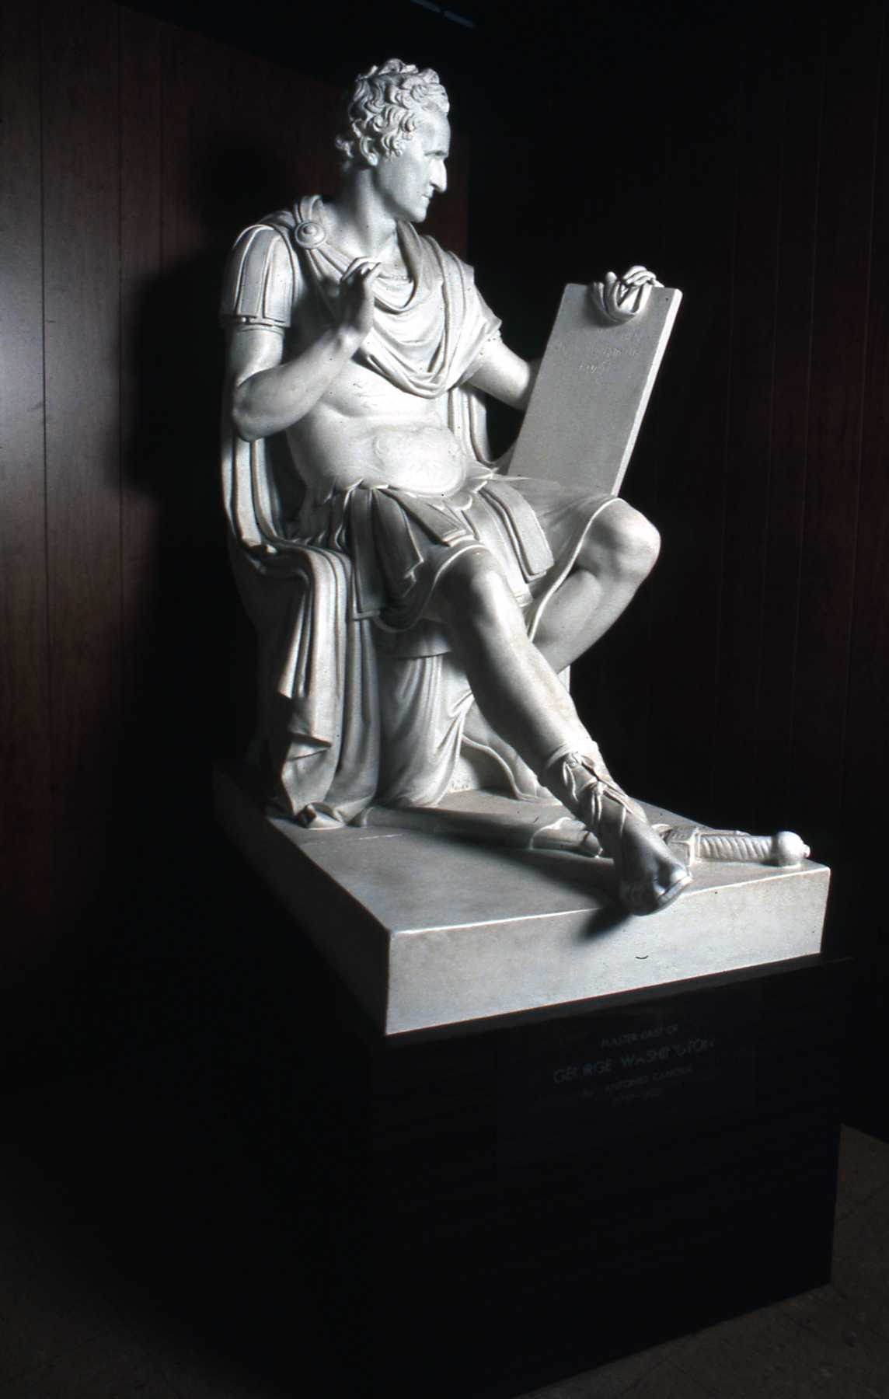
From Roma to Raleigh
George Washington’s
Journey To The NC Capitol
Copyright © 2010 by Rick Walton

Slide 2
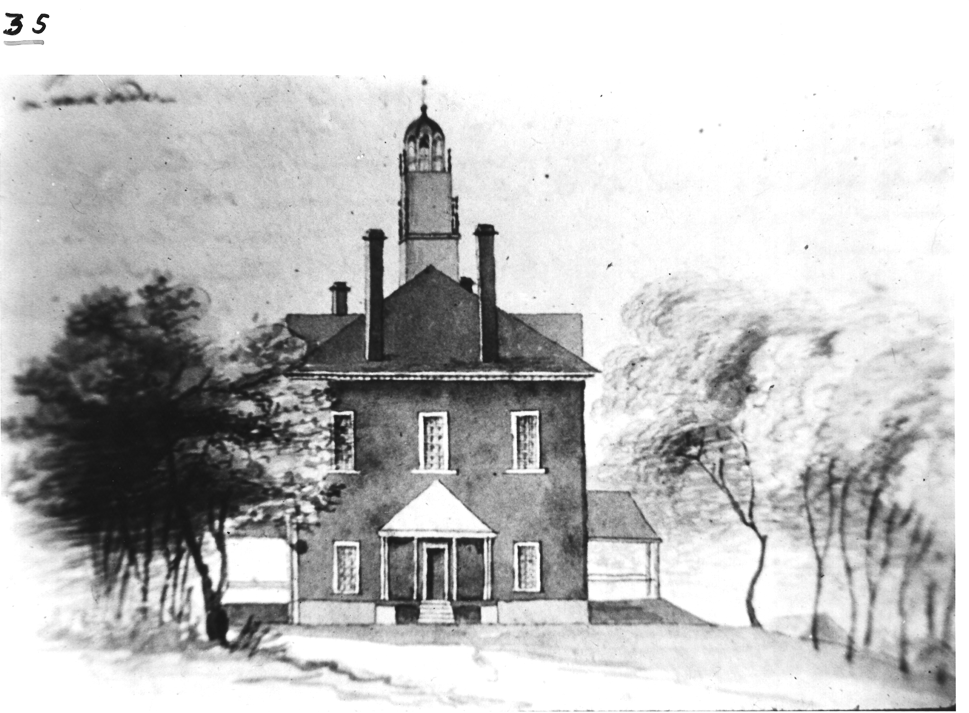
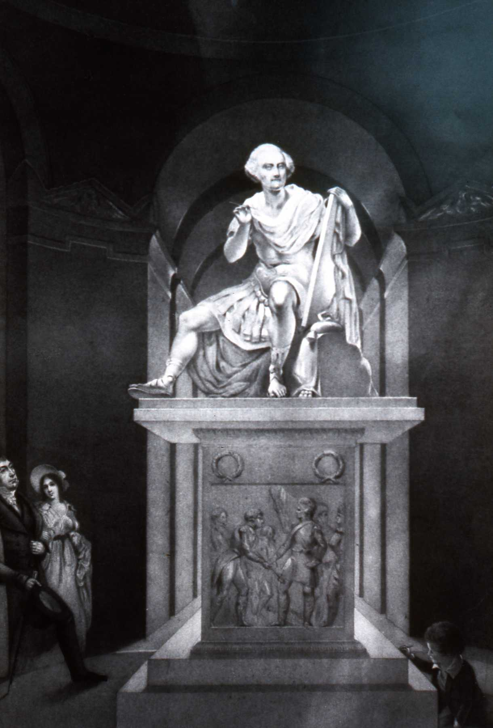
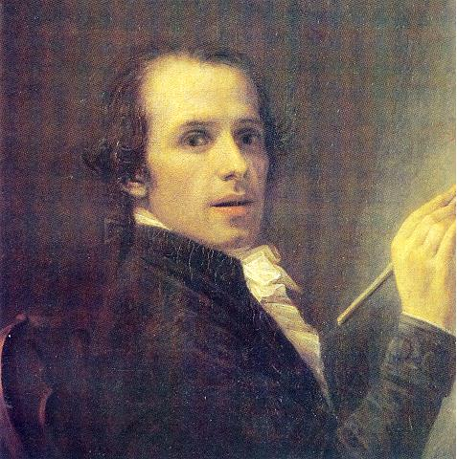
Archive Research Associates
Copyright © 2010 by Rick Walton
Antonio Canova
(1 November 1757 – 13 October 1822)
Notes:
Every story has a beginning ….So I guess the beginning of this one stretches way back to 1815 when the North Carolina legislature, in a patriot fervor fueled by the war of 1812, voted to obtain a statue of George Washington to grace their State House.
They engaged the famous Italian Artist Antonio Canova, who Thomas Jefferson called the “Greatest Sculptor alive”. Canova “agreed to sculpt the statue because of his enormous respect for Washington whom he called “a genius who has performed such sublime deeds for the safety of liberty of his country.”” (Quoted Source: Docent Guide)
The stature arrived in Raleigh to great fanfare in 1821 and was viewed by both North Carolinians and patrons of the arts who came from around the world to view this remarkable statue.

Slide 3
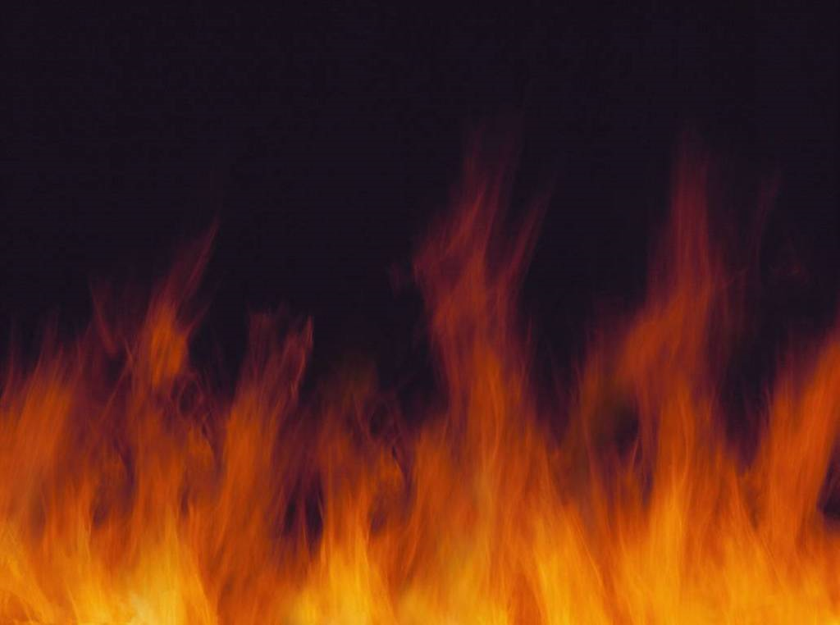
Archive Research Associates
Copyright © 2010 by Rick Walton
Notes:
In 1831 Disaster struck the statue when the state house was accidently burned to the ground. After only 10 years, the Canova masterpiece was totally destroyed

Slide 4
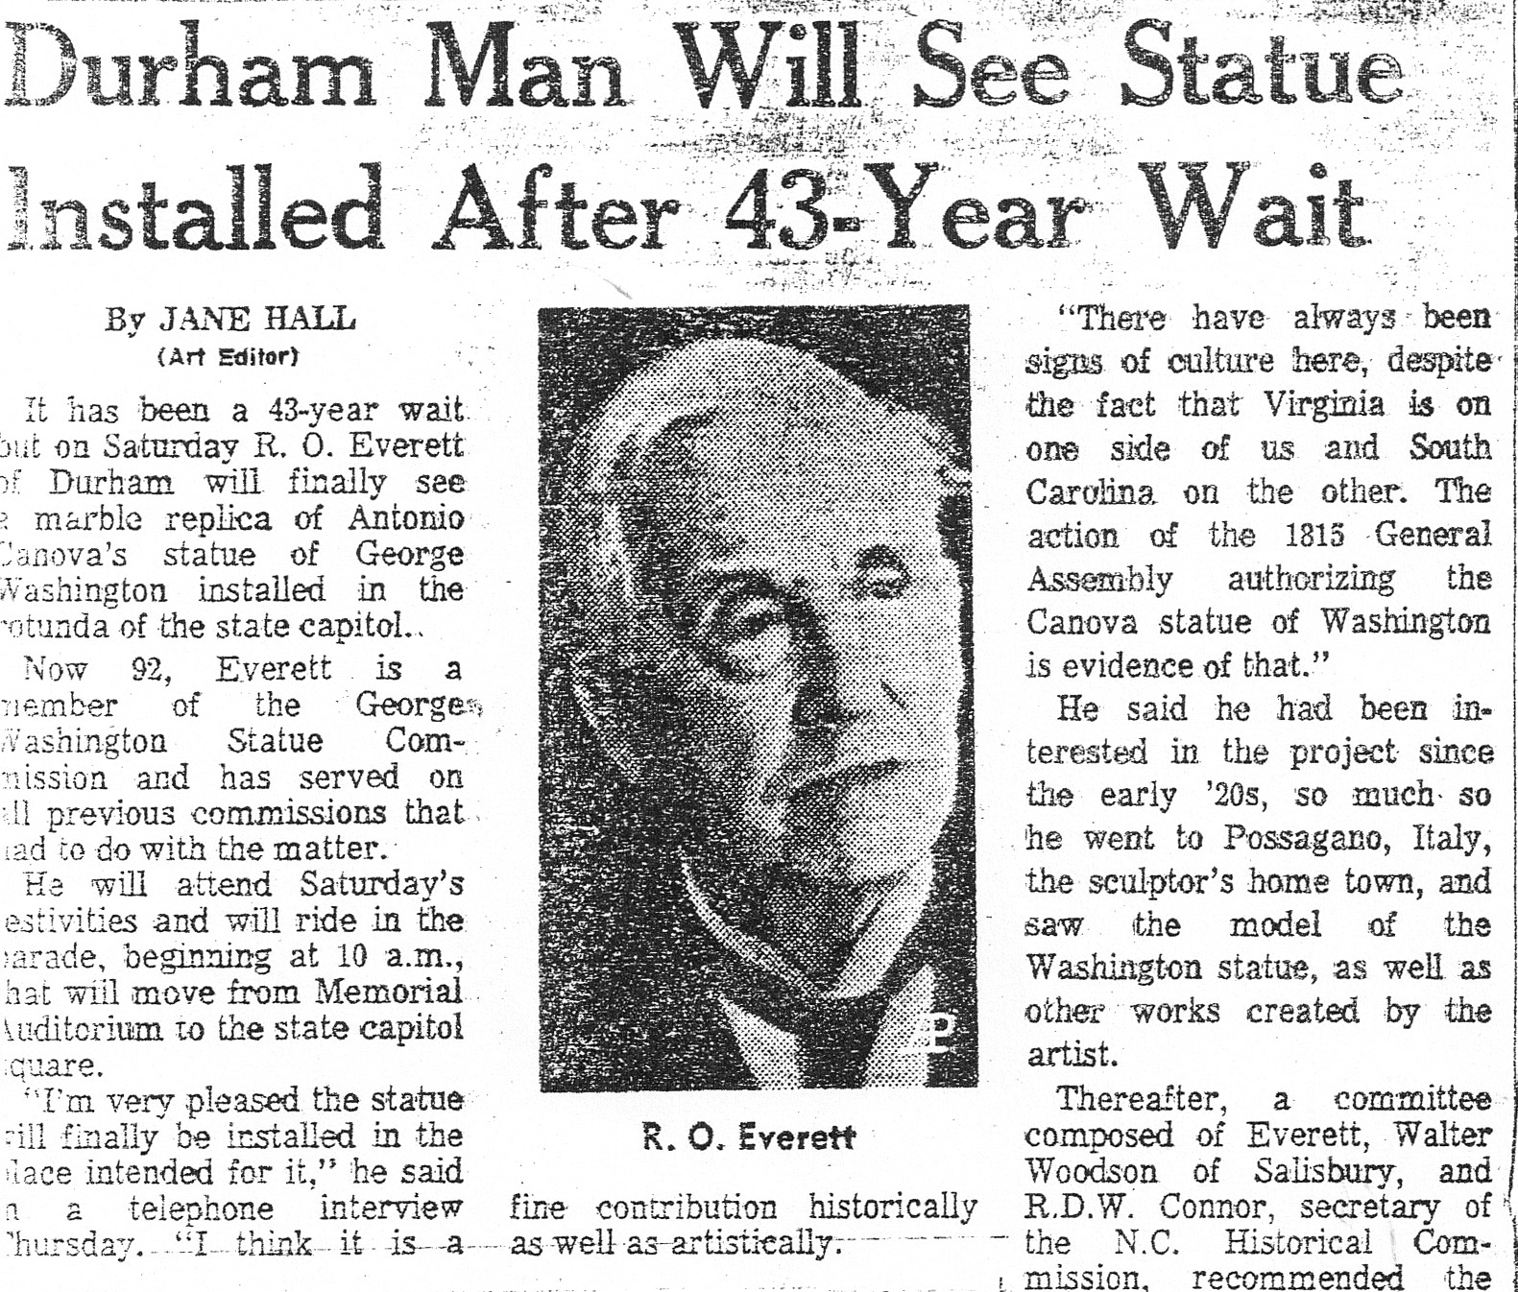
Archive Research Associates
Copyright © 2010 by Rick Walton
Notes:
Fast forward to the early 1920’s, and meet Reuben Oscar Everett, a successful Durham Lawyer serving in the House of representatives . Reuben shared a practice with his wife, Kathrine Robinson Everett (1893-1992), in Durham, N.C.
R. O. Everett, student of law in the first class at Trinity College, became the first Durham city attorney and the first prosecuting attorney in the Durham Recorder's Court, and served five terms in the state House of Representatives, 1921-1933.
Their son, Robinson O. Everett (1928- ), Duke University law professor and judge in the United States Court of Military Appeals, joined his mother and father in the firm of Everett, Everett and Everett, 1956-1968. In 1954, the three were the first father, mother, and son to be admitted to practice before the United States Supreme Court.
After visiting Canova’s home town of Possagano, Italy in the early 20’s, and seeing the life size plaster model of the statue, that once stood in his native state’s capitol, Everett joined a committee that requested funding from the 1923 General Assembly to sculpt a new statue from the original model. They refused to appropriate the funds. In 1925 Everett guided through an act authorizing the replica, but this time obtaining funds from private sources via subscription. Sadly the financial decline resulting in the Great Depression of 1929 ended any hopes of raising private funds for this project. Recovery and War prevented this from being reconsidered for nearly half a century. But Everett never forgot the statue in 1970 said
“ I never forgot the idea, and when the time came I was happy to serve on the present commission headed by (State Senator) Hector MacLean”.

Slide 5
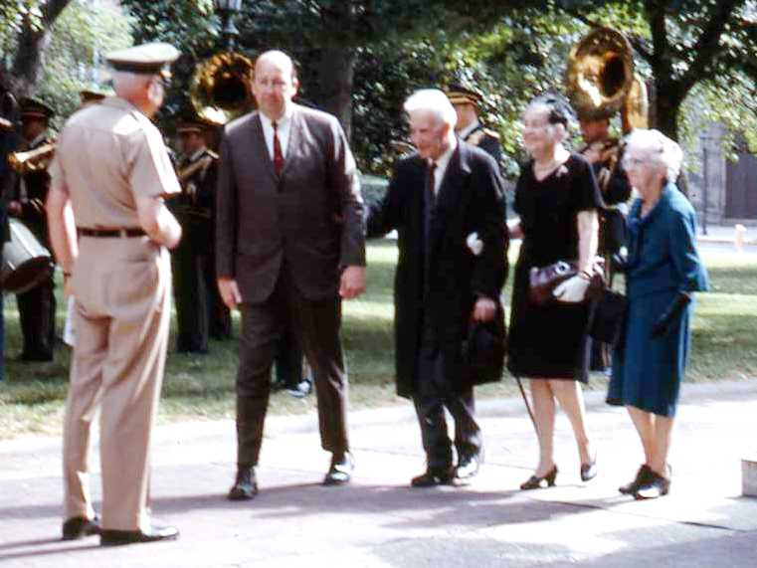
92 year old R. O. Everett and his Wife Kathleen
Archive Research Associates
Copyright © 2010 by Rick Walton
Reuben Oscar Everett (1879-1971)
Kathrine Robinson Everett (1893-1992)
Source: N. C. Capitol Slide Digitization Project
Slide : CI-1-8L-18cu
Notes:
Finally on Memorial Day, Saturday, May 30, 1970, 92 year old Reuben Oscar Everett was on hand to witness the fulfillment of a lifelong dream. He died the following year after a lifetime of public service.

Slide 6
Is it REALLY
Canova’s
Statue?
Archive Research Associates
Copyright © 2010 by Rick Walton

Slide 7
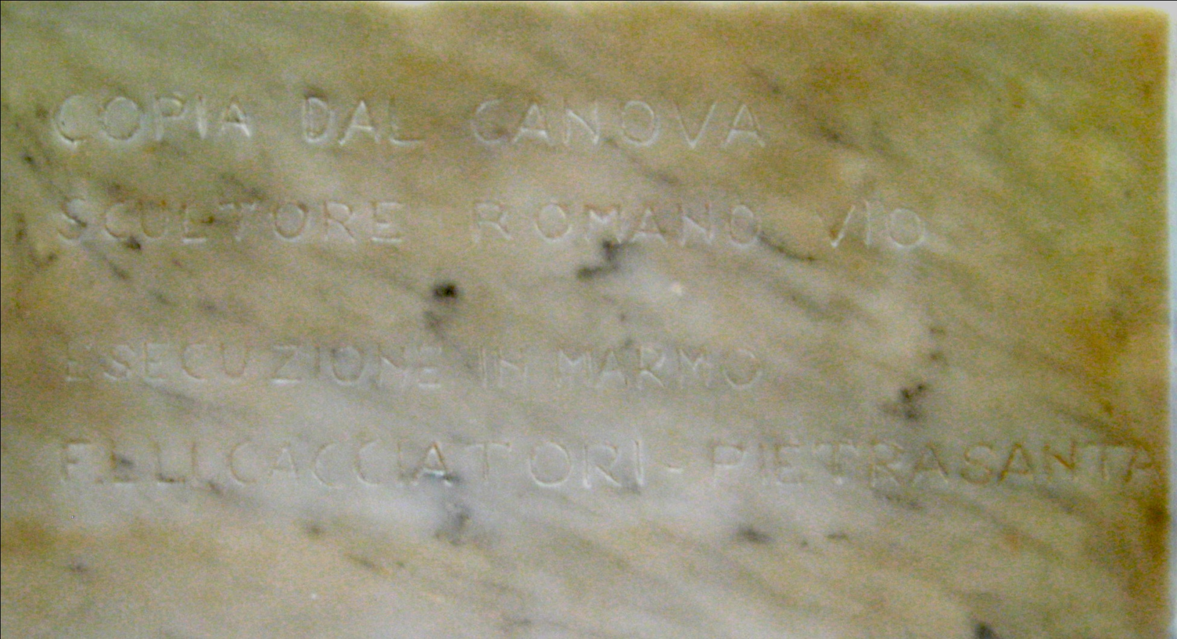
Inscription on rear base of monument
Copy of Canova Sculpture by Romano Vio
Archive Research Associates
Copyright © 2010 by Rick Walton
Implementation in marble
Pietrasanta is a town and commune on the coast of northern Tuscany in Italy, in the province of Lucca.
Source: Photo by Rick Walton 2010
Notes:
Senator Hector MacLean said, in 1970 ”The Statue is not a replica, but a duplicate from the original because It was carved from Canova’s original plaster model in Possagano, Italy .”
On the rear base of the statue is an obscure marking that says, in Italian, Copy of Canova Sculpture by Romano Vio / Implementation in marble/
The last two or three? words are a puzzle, Elli Cacciatori Pietrasanta
Pietrasanta is a town and commune on the coast of northern Tuscany in Italy, in the province of Lucca.
And I believe cacciatori is a sculping studio there.
This translation needs a little more work….

Slide 8
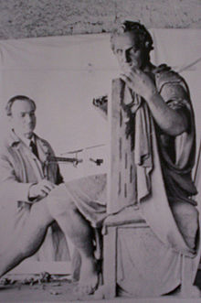
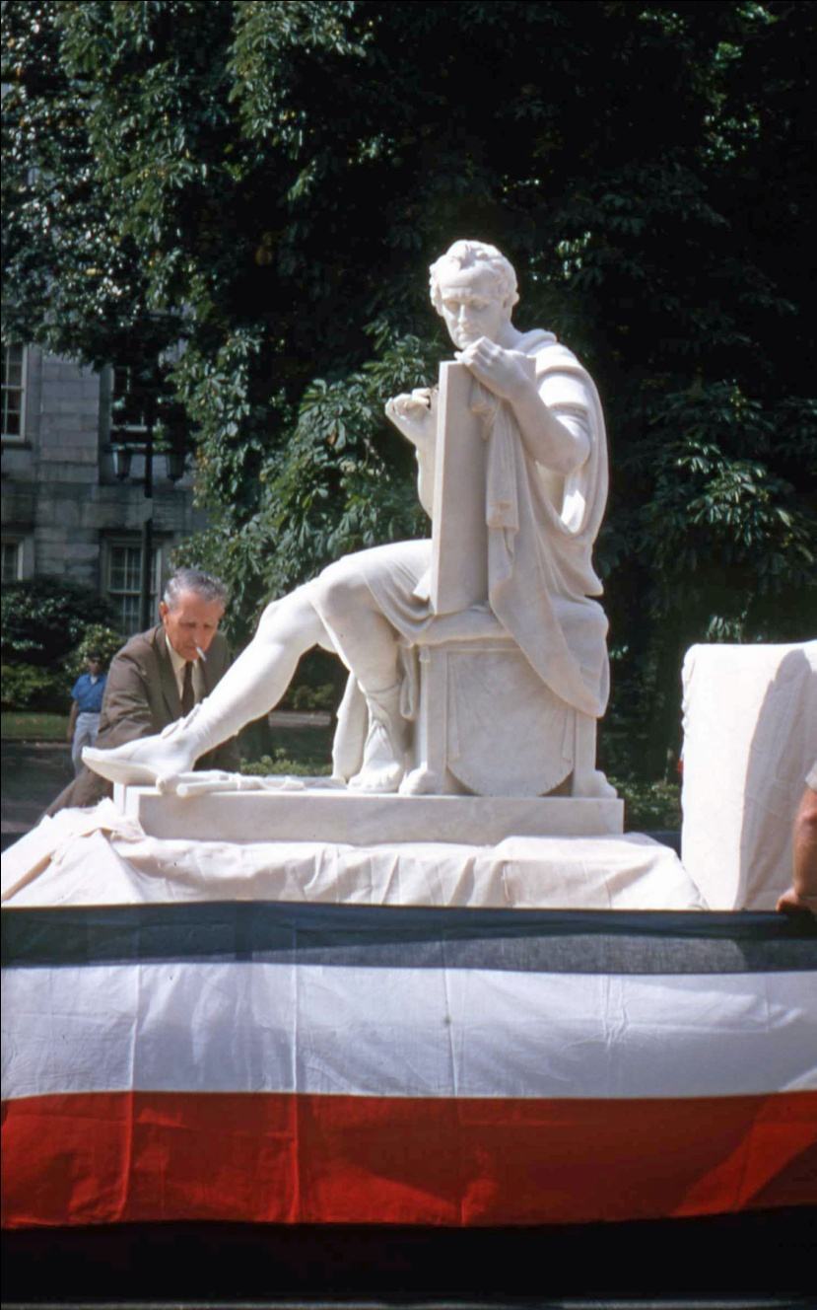
Italian Sculptor Professor Romano Vio
( 11 Feb 1913 -23 Aug 1984)
Archive Research Associates
Copyright © 2010 by Rick Walton
Source: Wikipedia on Internet
Notes:
In this rare photo, placed on the internet by the Artist, We see Professor Romano Vio at work on the statue. While Canova may have been the designer, Romano Vio is clearly the artist whose hands lovingly sculpted the lifelike features of the stature that graces our rotunda today.
A comparison to the completed statue illustrates that this is, in Fact, the Statue of George Washington being created, seen here for perhaps the first time by this audience.

Slide 9
Arriving
At
Norfolk
Archive Research Associates
Copyright © 2010 by Rick Walton

Slide 10
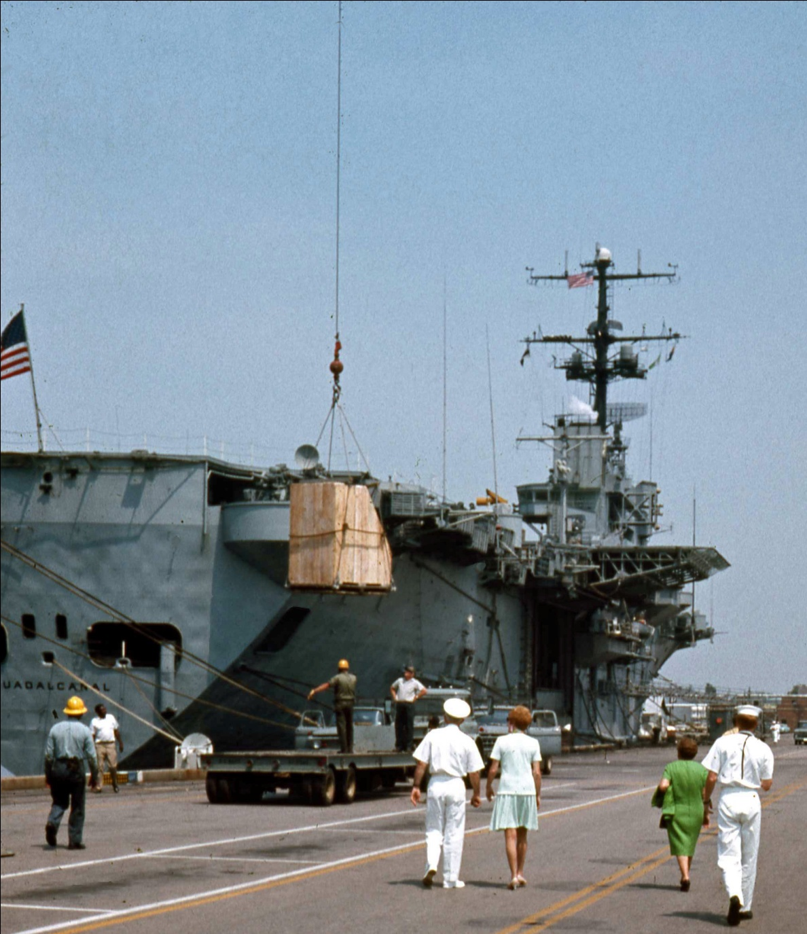
Statue in Crate at Norfolk Naval base
Unloaded from USS Neosho (on left, out of frame)
Archive Research Associates
Copyright © 2010 by Rick Walton
Source: N. C. Capitol Slide Digitization Project
Slide : CI-1-8A-003e, N&O article Friday 22 May 1970
Notes:
Once Artist Romano Vio completed the statue, it was crated and sent to Livorno, Italy for shipment to Raleigh. The U.S. Navy provided free transportation for the statue aboard the USS NEOSHO which left Livorno Italy On April 23, 1970 and arrived in Norfolk on Friday, May 23, 1970
What we are seeing in this photograph is the Packing crate being lowered to the dock from the Neosho, which would be coming off the ship out of frame, to the photographers left, not the carrier directly in front.

Slide 11
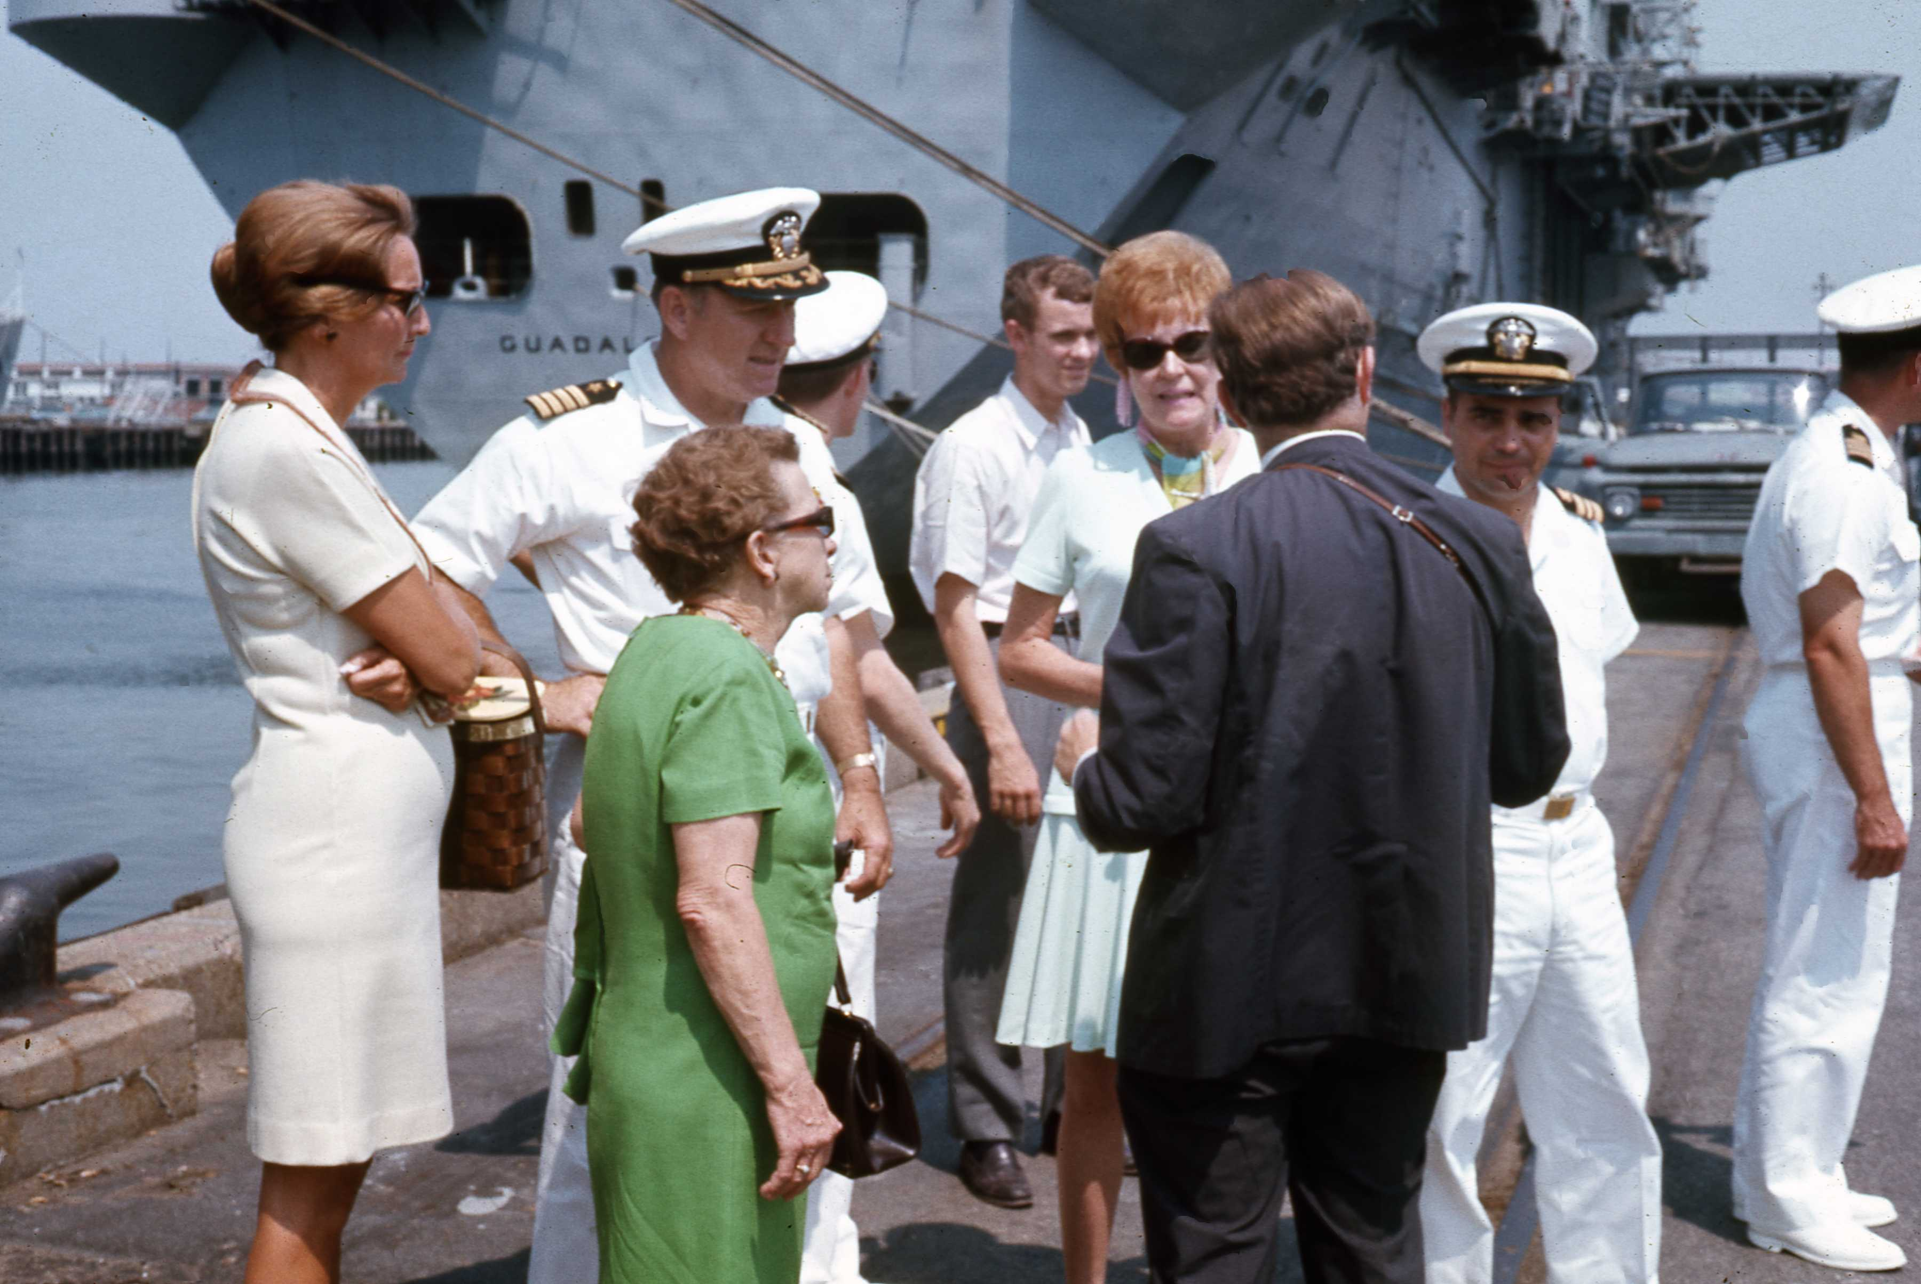
North Carolina Delegation:
Dr. Louise Hall (Duke University Architectural Historian)
Mrs. John B. Chase (NC Rep from Wayne County)
Ben Williams (Curator, NC Museum of Art)
Archive Research Associates
Copyright © 2010 by Rick Walton
Source: N. C. Capitol Slide Digitization Project
Slide : CI-1-8A-011, N&O article Friday 22 May 1970
Notes:
According to a May 22, 1970 N&O article, The George Washington Statue Commission sent three members to Norfolk to meet the arriving statue. They are Pictured here:
Dr. Louise Hall (Duke University Architectural Historian)
Mrs. John B. Chase (NC Rep from Wayne County)
Ben Williams (Curator, NC Museum of Art) (with his back to us)

Slide 12
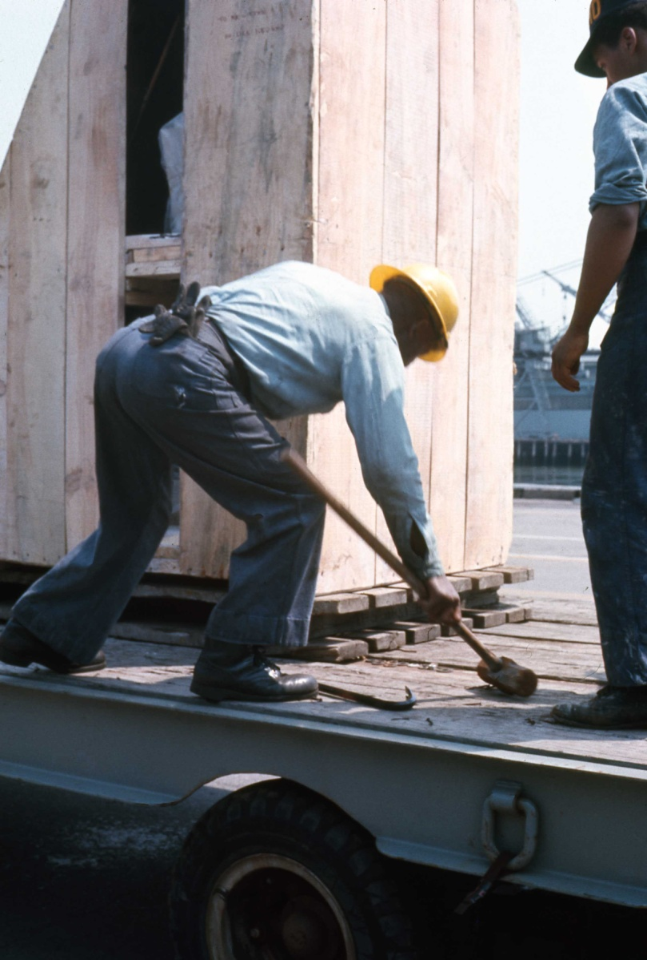
Statue loaded on a truck provided by
Moss Trucking Co. of Charlotte
and transported to Raleigh.
Archive Research Associates
Copyright © 2010 by Rick Walton
Source: N. C. Capitol Slide Digitization Project
Slide : CI-1-8A-007, N&O article Friday 22 May 1970
Notes:
The Statue was loaded on a truck provided by Moss Trucking Co. of Charlotte who donated their services to the project. Once secured, the crate began its long Journey to Raleigh.

Slide 13
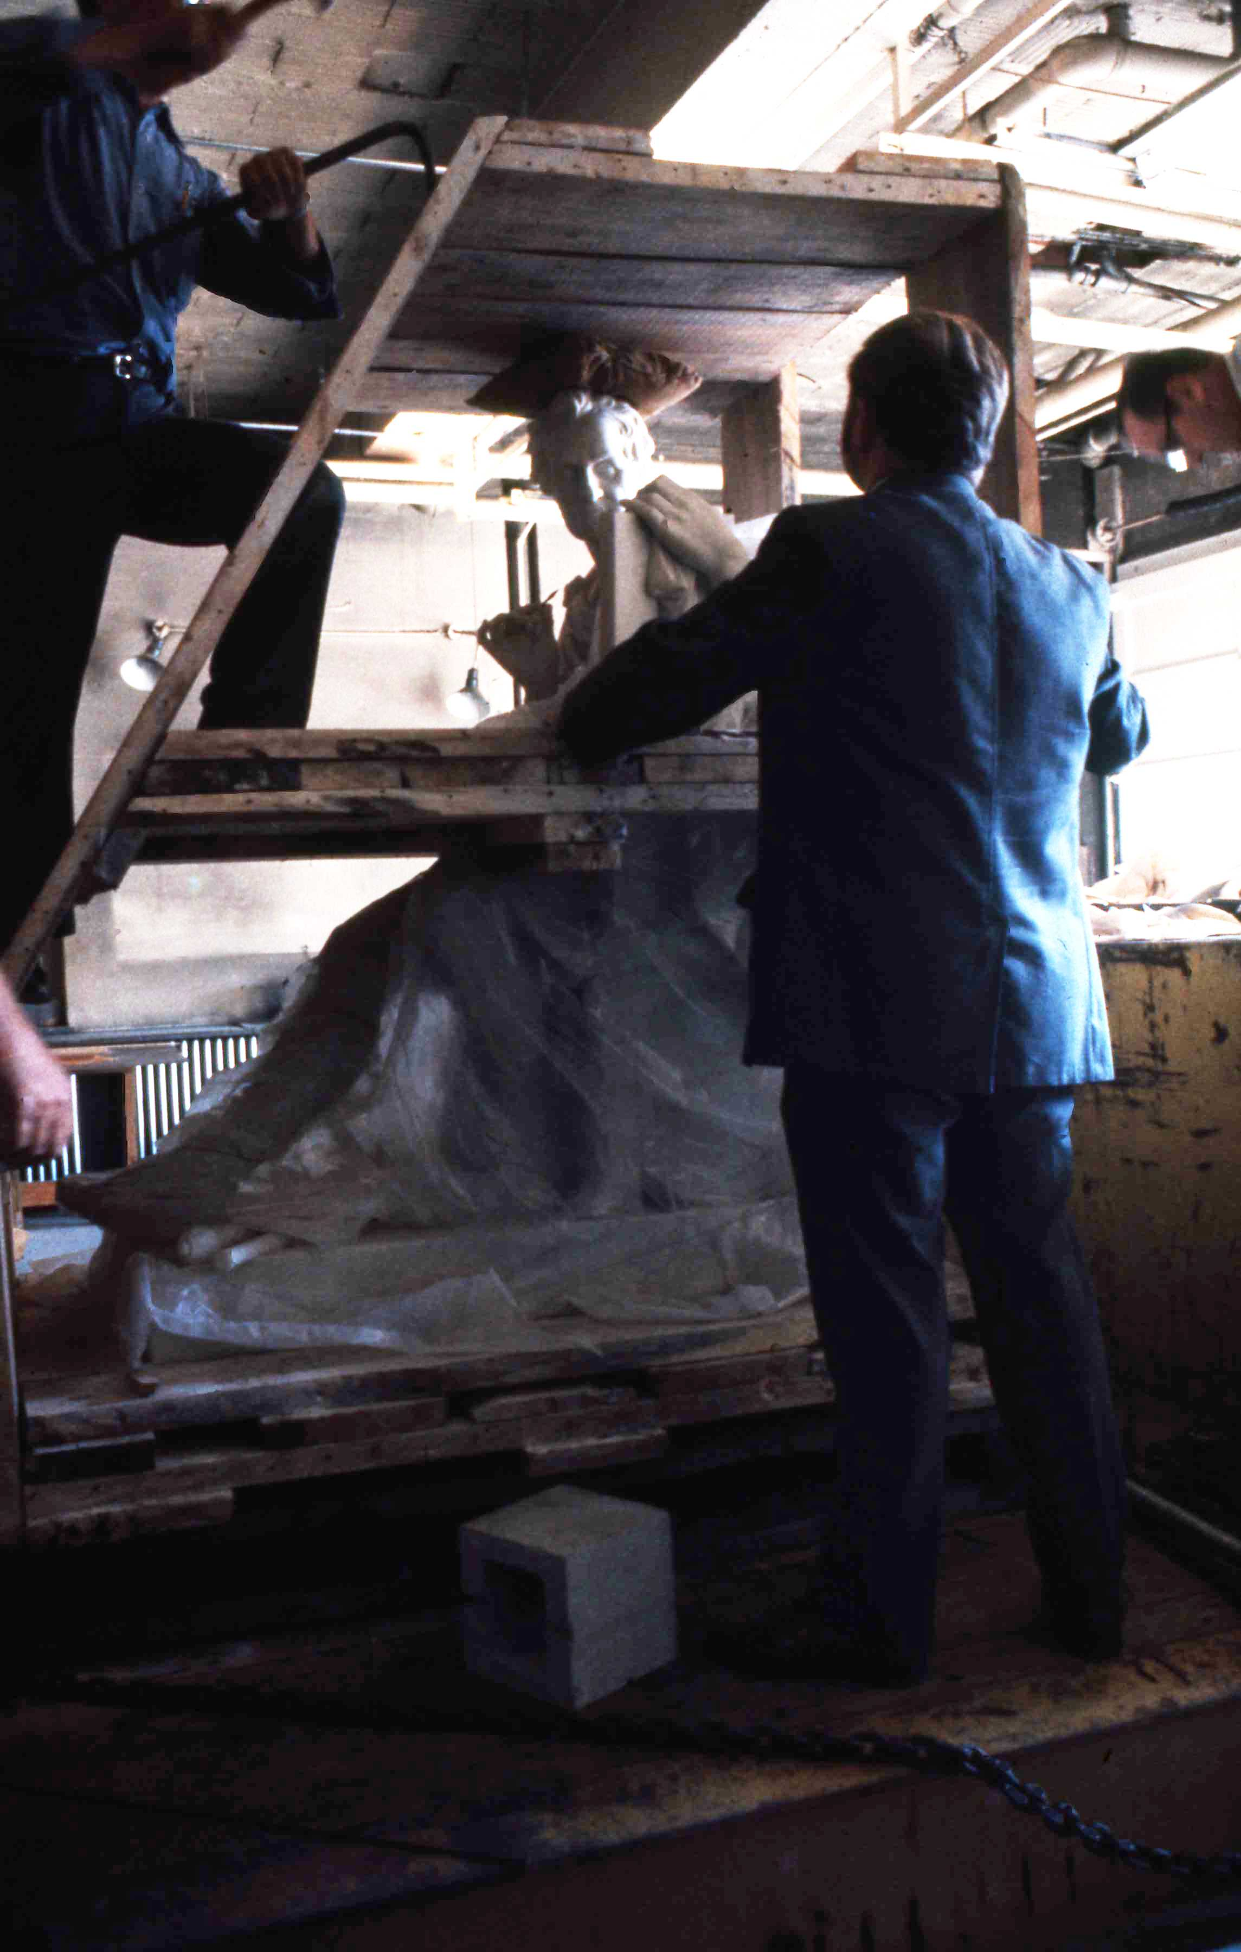
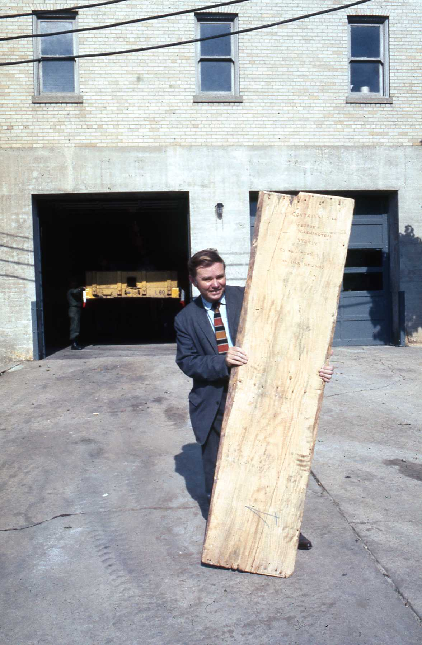
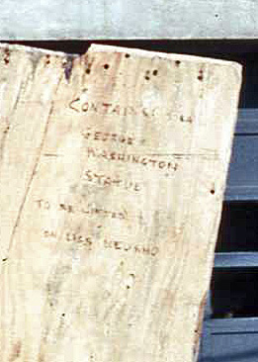
Statue uncrated, inspected and stored until the parade
Archive Research Associates
Copyright © 2010 by Rick Walton
Ben Williams,
N.C. Museum of Art
Source: N. C. Capitol Slide Digitization Project
Slide: CI-1-8A-008, CI-1-8B-005, CI-1-8B-005e
Notes:
In these photos we see the busy Ben Williams, of the North Carolina Museum of art inspecting the statue and holding a piece of the packing crate.
When we look closely at the lettering it says: Contains George Washington Statue to: (unreadable) on USS Neosho

Slide 14
The
Parade
Archive Research Associates
Copyright © 2010 by Rick Walton
Notes:
On Saturday, May 30, 1970, the N&O announced “the statue will be installed in the rotunda today, the festivities begin at 10 am with a parade from Memorial Auditorium to the East side of the Capitol.”

Slide 15
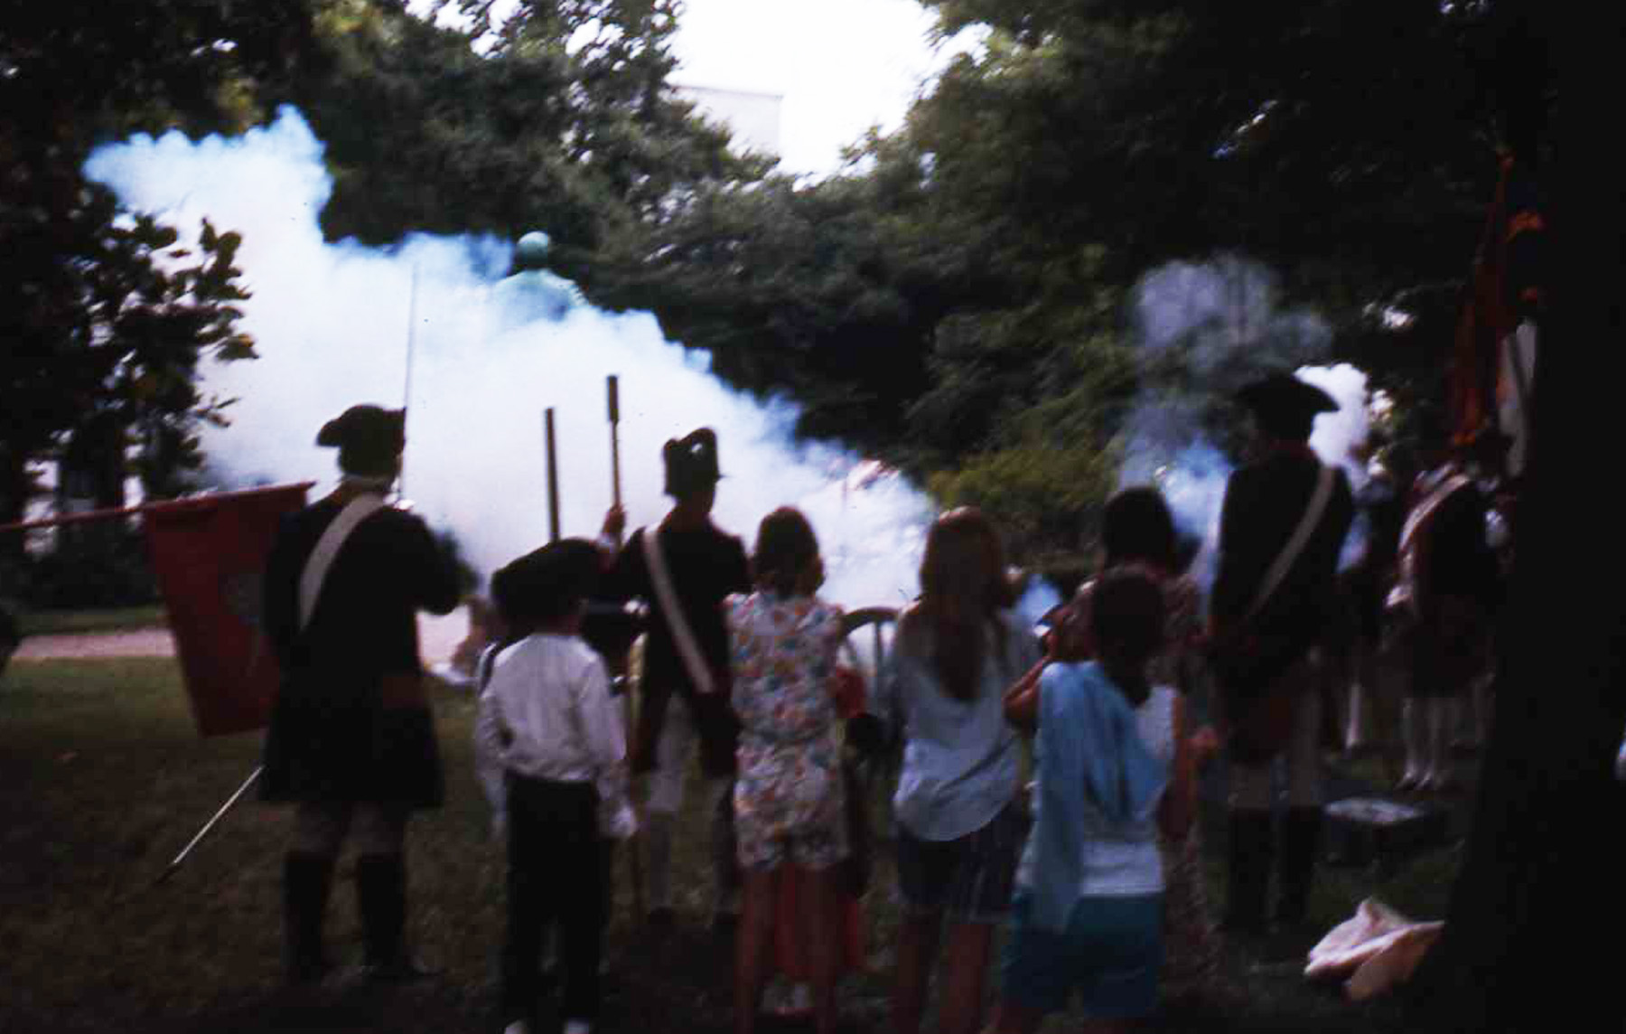
Saturday, May 30, 1970
Memorial Day Parade Starts with a BANG
Archive Research Associates
Copyright © 2010 by Rick Walton
Hillsborough Light Rifles
Source: N. C. Capitol Slide Digitization Project
Slide : CI-1-8I-010e, N&O article Friday 22 May 1970
Notes:
The N&O reported the Festivities, including the order of March. According to one article, comparing the gala event to the original dedication ceremony in 1821, The Hillsborough Light Rifles place their artillery on the lawn of the capitol and fired a signal to begin the Parade, from the memorial auditorium at the opposite end of Fayetteville street.

Slide 16
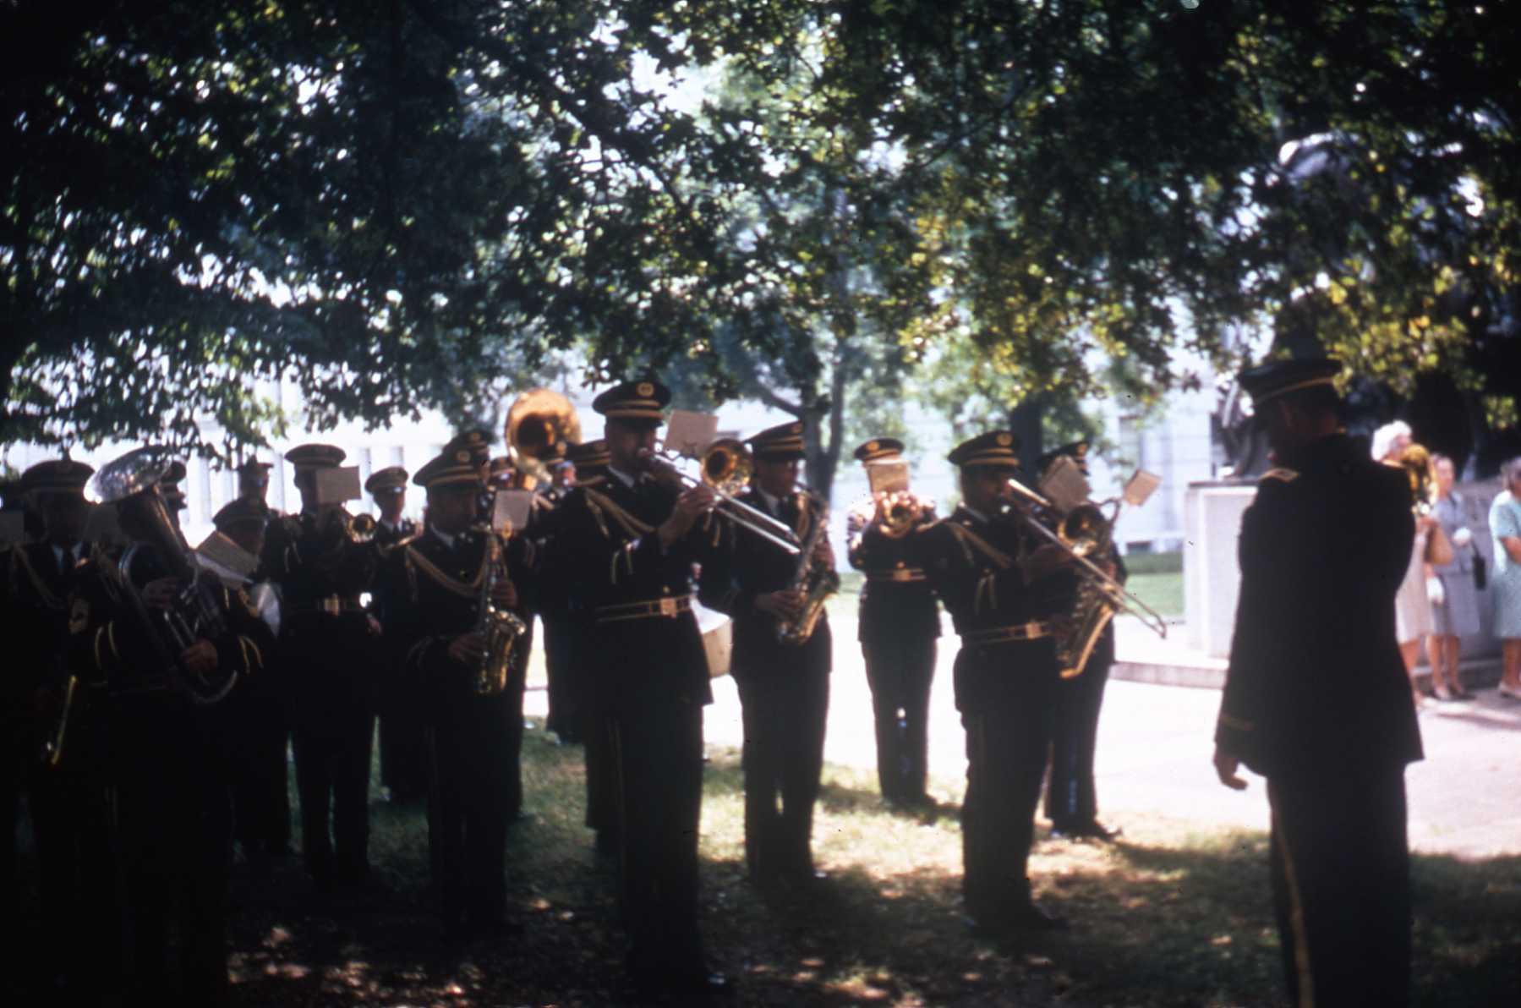
Saturday, May 30, 1970
Memorial Day Parade Military Band
Archive Research Associates
Copyright © 2010 by Rick Walton
30th Infantry Division (Mechanized)
N. C. Army National Guard
Source: N. C. Capitol Slide Digitization Project
Slide : CI-1-8I-006 , N&O article Friday 22 May 1970 & 30 May 1970
Notes:
The Parade was led off by a “band of Music” performed by the 30th Infantry Division (Mechanized) N. C. Army National Guard

Slide 17
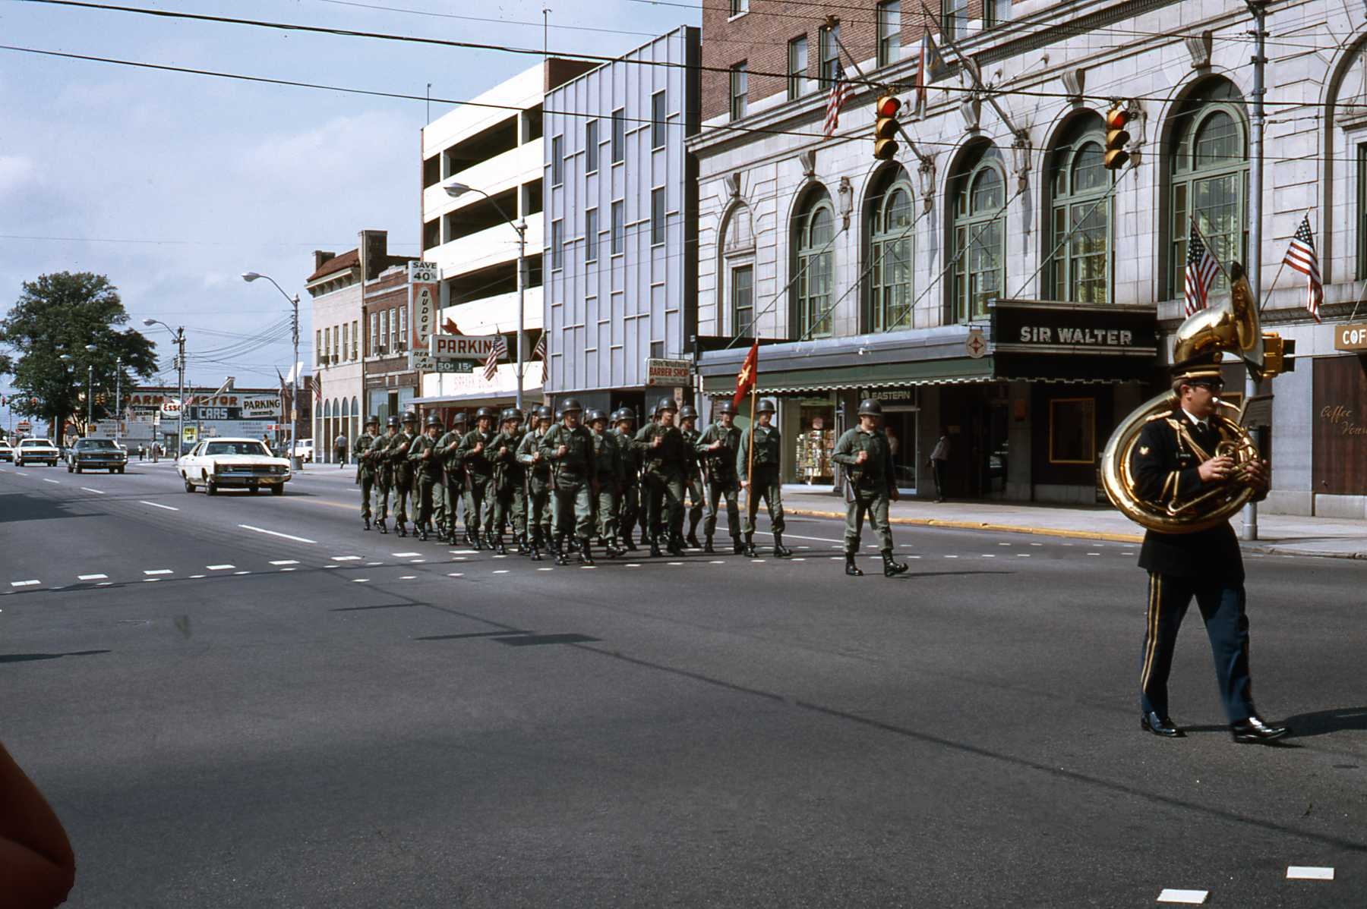
Saturday, May 30, 1970
Memorial Day Parade Military Marchers
Archive Research Associates
Copyright © 2010 by Rick Walton
Source: N. C. Capitol Slide Digitization Project
Slide : CI-1-8k-006, N&O article Friday 22 May 1970
Notes:
Followed by “the military”

Slide 18
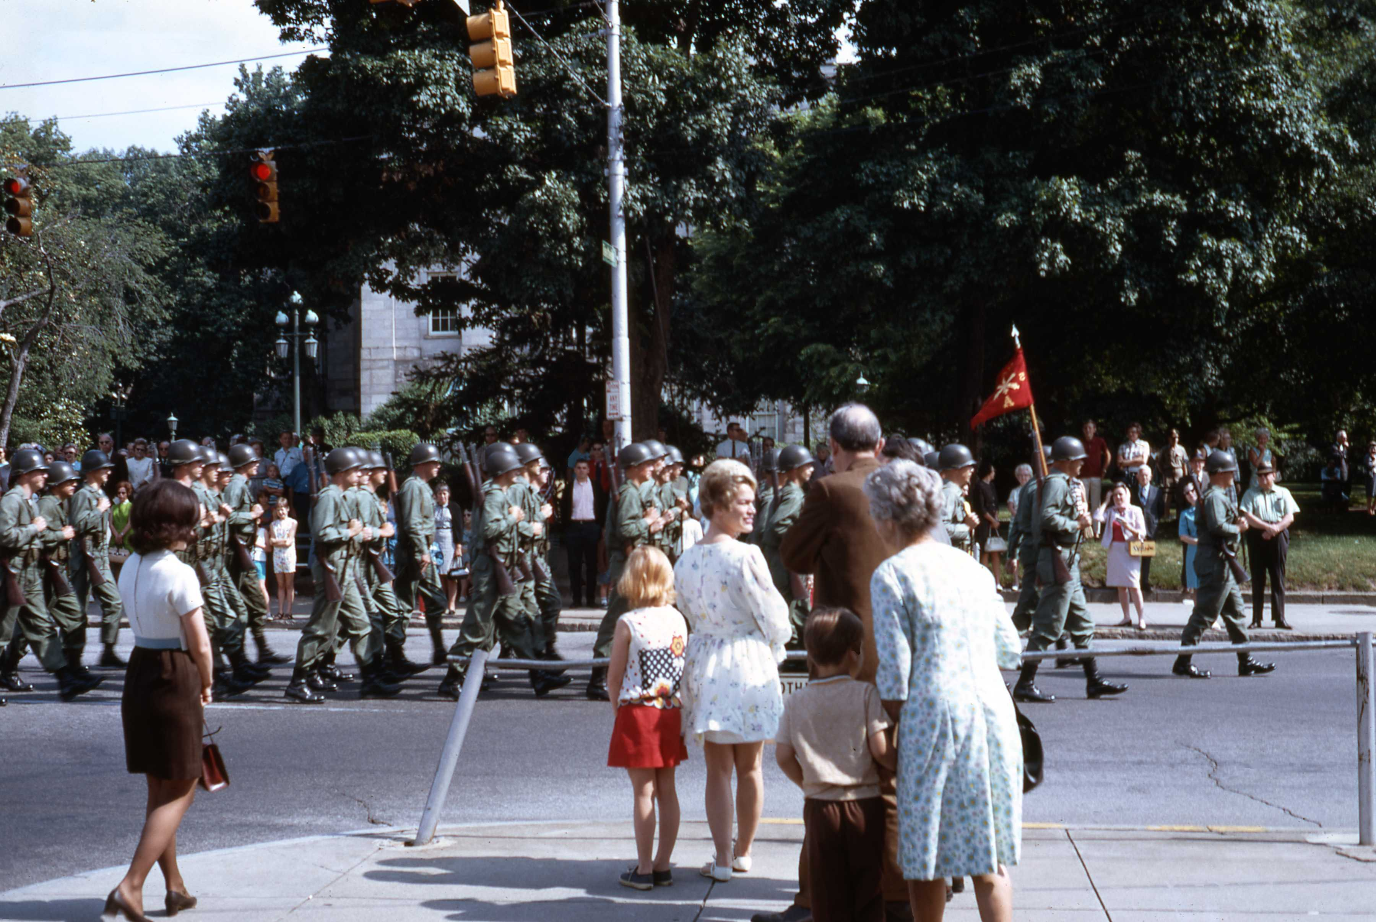
Saturday, May 30, 1970
Memorial Day Parade Military Marchers
Archive Research Associates
Copyright © 2010 by Rick Walton
Source: N. C. Capitol Slide Digitization Project
Slide : CI-1-8G-007, N&O article Friday 22 May 1970
Notes:
Represented by a platoon from Battery A, 5th Bn., 13th Artillery Who were carrying the colors of the Headquarters and headquarters company of the 30th infantry division.

Slide 19
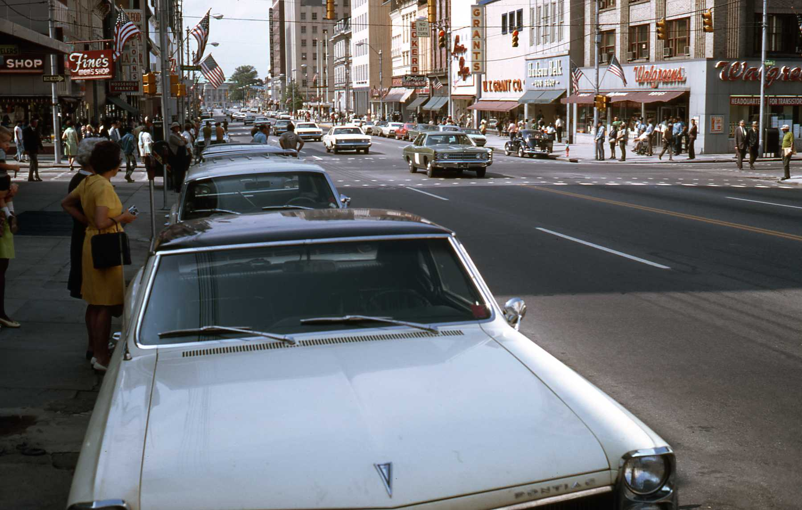
Saturday, May 30, 1970
Members of Statue Commission and other official’s Cars
Archive Research Associates
Copyright © 2010 by Rick Walton
Source: N. C. Capitol Slide Digitization Project
Slide : CI-1-8k-009, N&O article Friday 22 May 1970
Notes:
Followed by members of the George Washington statue commission, the council of state, and other local officials riding in automobiles.
Notice the Memorial auditorium in the rear center and the stunning view of Fayetteville street as it appeared over 40 years ago, in 1970.

Slide 20
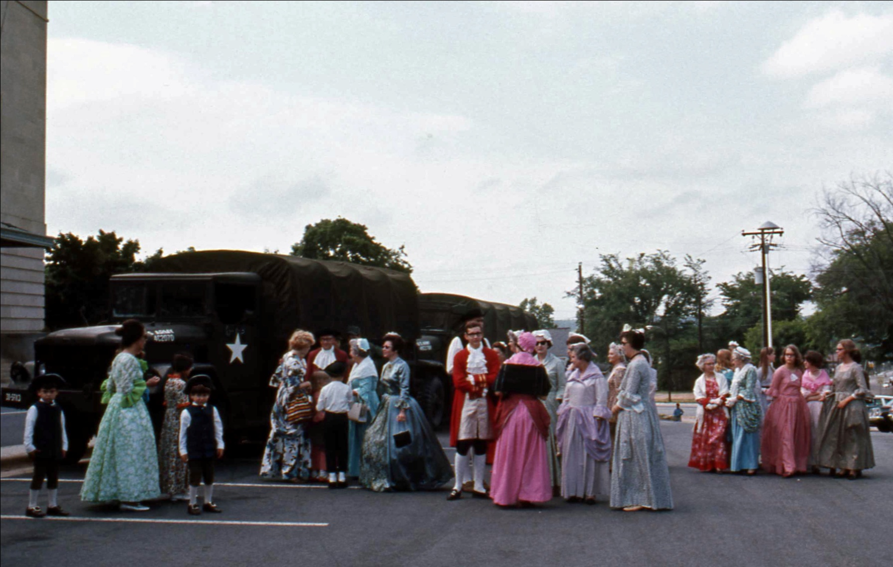
Saturday, May 30, 1970
Memorial Day Parade Colonial Citizen Marchers
Archive Research Associates
Copyright © 2010 by Rick Walton
Source: N. C. Capitol Slide Digitization Project
Slide : CI-1-8G-004e, N&O article Friday 22 May 1970
Notes:
Next came costumed colonial citizens.

Slide 21
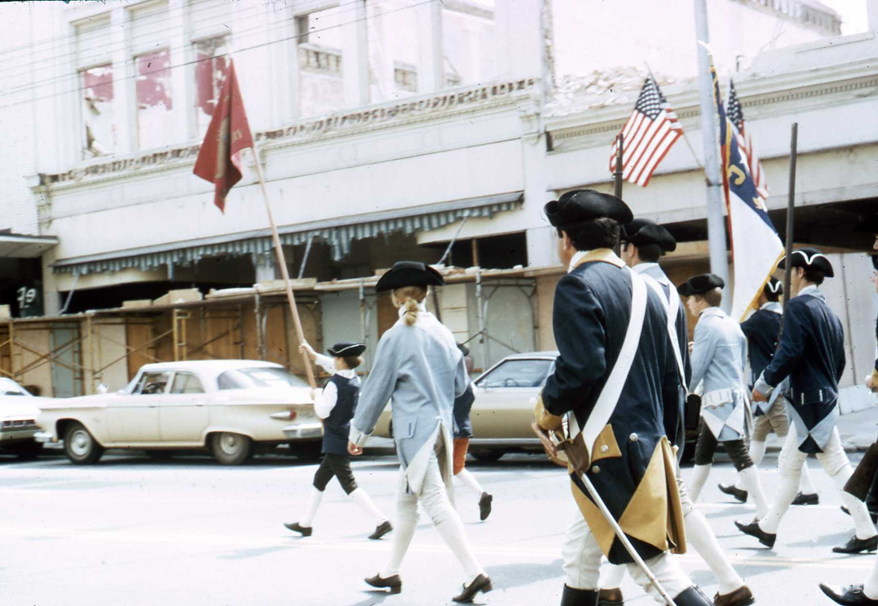
Saturday, May 30, 1970
Memorial Day Parade- Revolutionary War Soldiers
Archive Research Associates
Copyright © 2010 by Rick Walton
Source: N. C. Capitol Slide Digitization Project
Slide : CI-1-8M-002, N&O article Friday 22 May 1970
Notes:
Followed by Hillsborough Colonial Fife and Drum corps

Slide 22
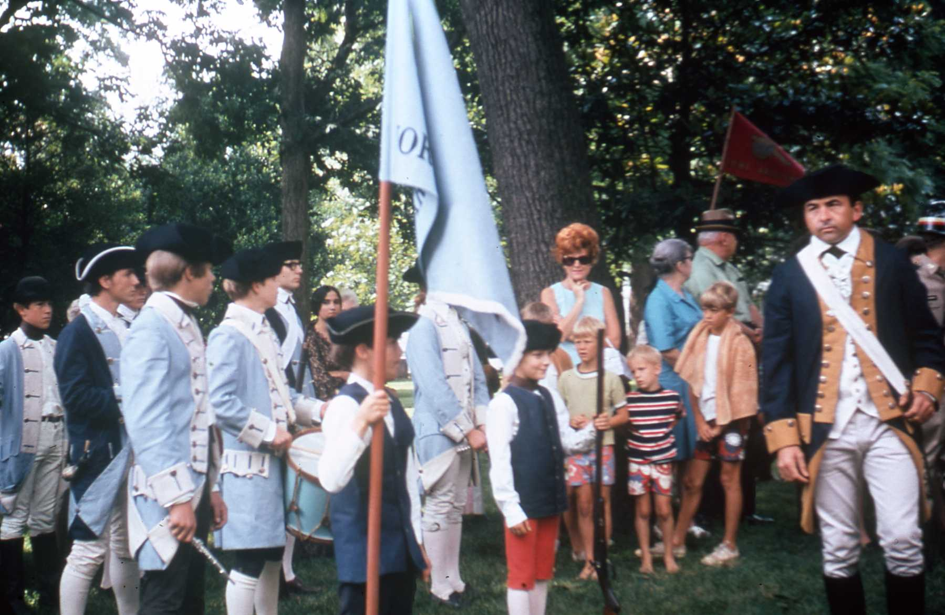
Saturday, May 30, 1970
Memorial Day Parade- Revolutionary War Soldiers
Archive Research Associates
Copyright © 2010 by Rick Walton
Source: N. C. Capitol Slide Digitization Project
Slide : CI-1-8I-014, N&O 5/30/1970
Notes:
Who were portraying the Revolutionary War soldiers, who marched in this position during the 1821 parade.

Slide 23
Saturday, May 30, 1970
Memorial Day Parade Welcomes Statue
Archive Research Associates
Copyright © 2010 by Rick Walton
Source: N. C. Capitol Slide Digitization Project
Slide : CI-1-8G-002e
Notes:
And Finally George Washington himself, Dressed as a roman General.
Quoted from N&O 5/30/70 from the 1849 book “the works of Antonio Canova in Sculpture and Modeling” This description provided by countess Allbrizzi:
“…The fine Tunic which he wears is seen only at the knee, being covered by an ample ornamented cuirass ((kwĭ-răs') pronounced Kwa-Rahzz) (metal breastplate); above which is a magnificent mantle fastened by a clasp on the right shoulder and flowing down in Majestic Folds, Beneath his right foot, which is extended forward, is a parazonium (pronounced Pair–a-zone-E-um)(Short Sword) sheathed, and a scepter, signifying that the successful termination of the war and the establishment of the laws has rendered them now useless.”

Slide 24
The
Dedication
Ceremony
Archive Research Associates
Copyright © 2010 by Rick Walton

Slide 25
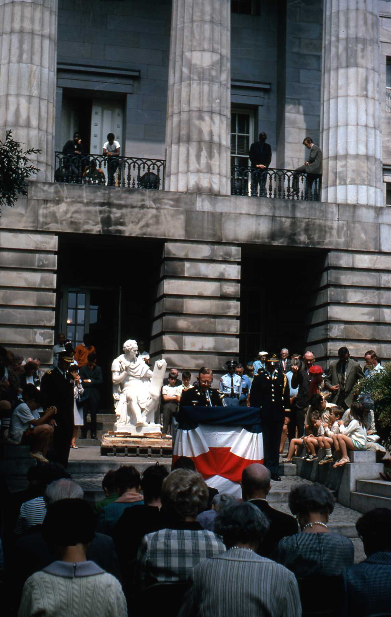
Saturday, May 30, 1970
Invocation by Lt. Col. James W. McGinnis, Chaplain of NC Natl Guard
Archive Research Associates
Copyright © 2010 by Rick Walton
Source: N. C. Capitol Slide Digitization Project
Slide : CI-1-8J-008

Slide 26
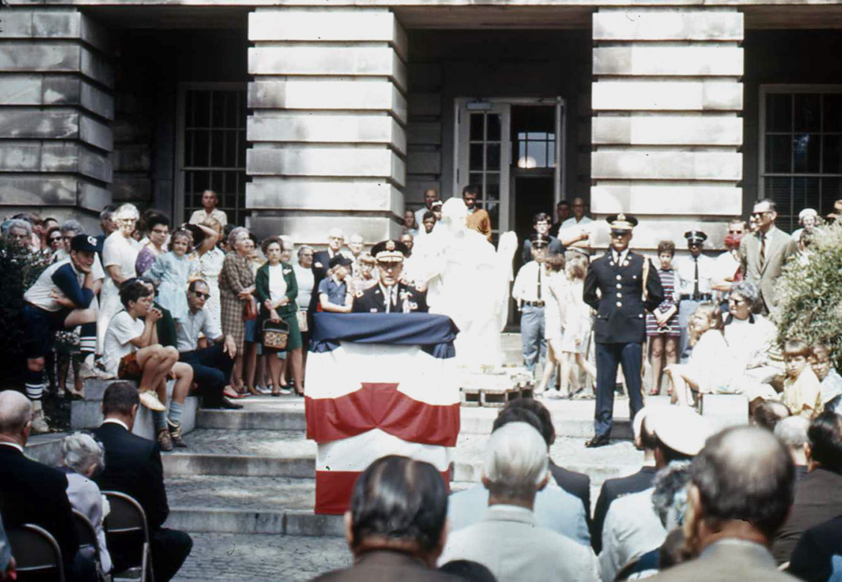
Saturday, May 30, 1970
Parade Grand Marshal and MC
Maj. Gen. Ferd Davis, Adjutant-general of NC
Archive Research Associates
Copyright © 2010 by Rick Walton
Source: N. C. Capitol Slide Digitization Project
Slide : CI-1-8H-010e

Slide 27
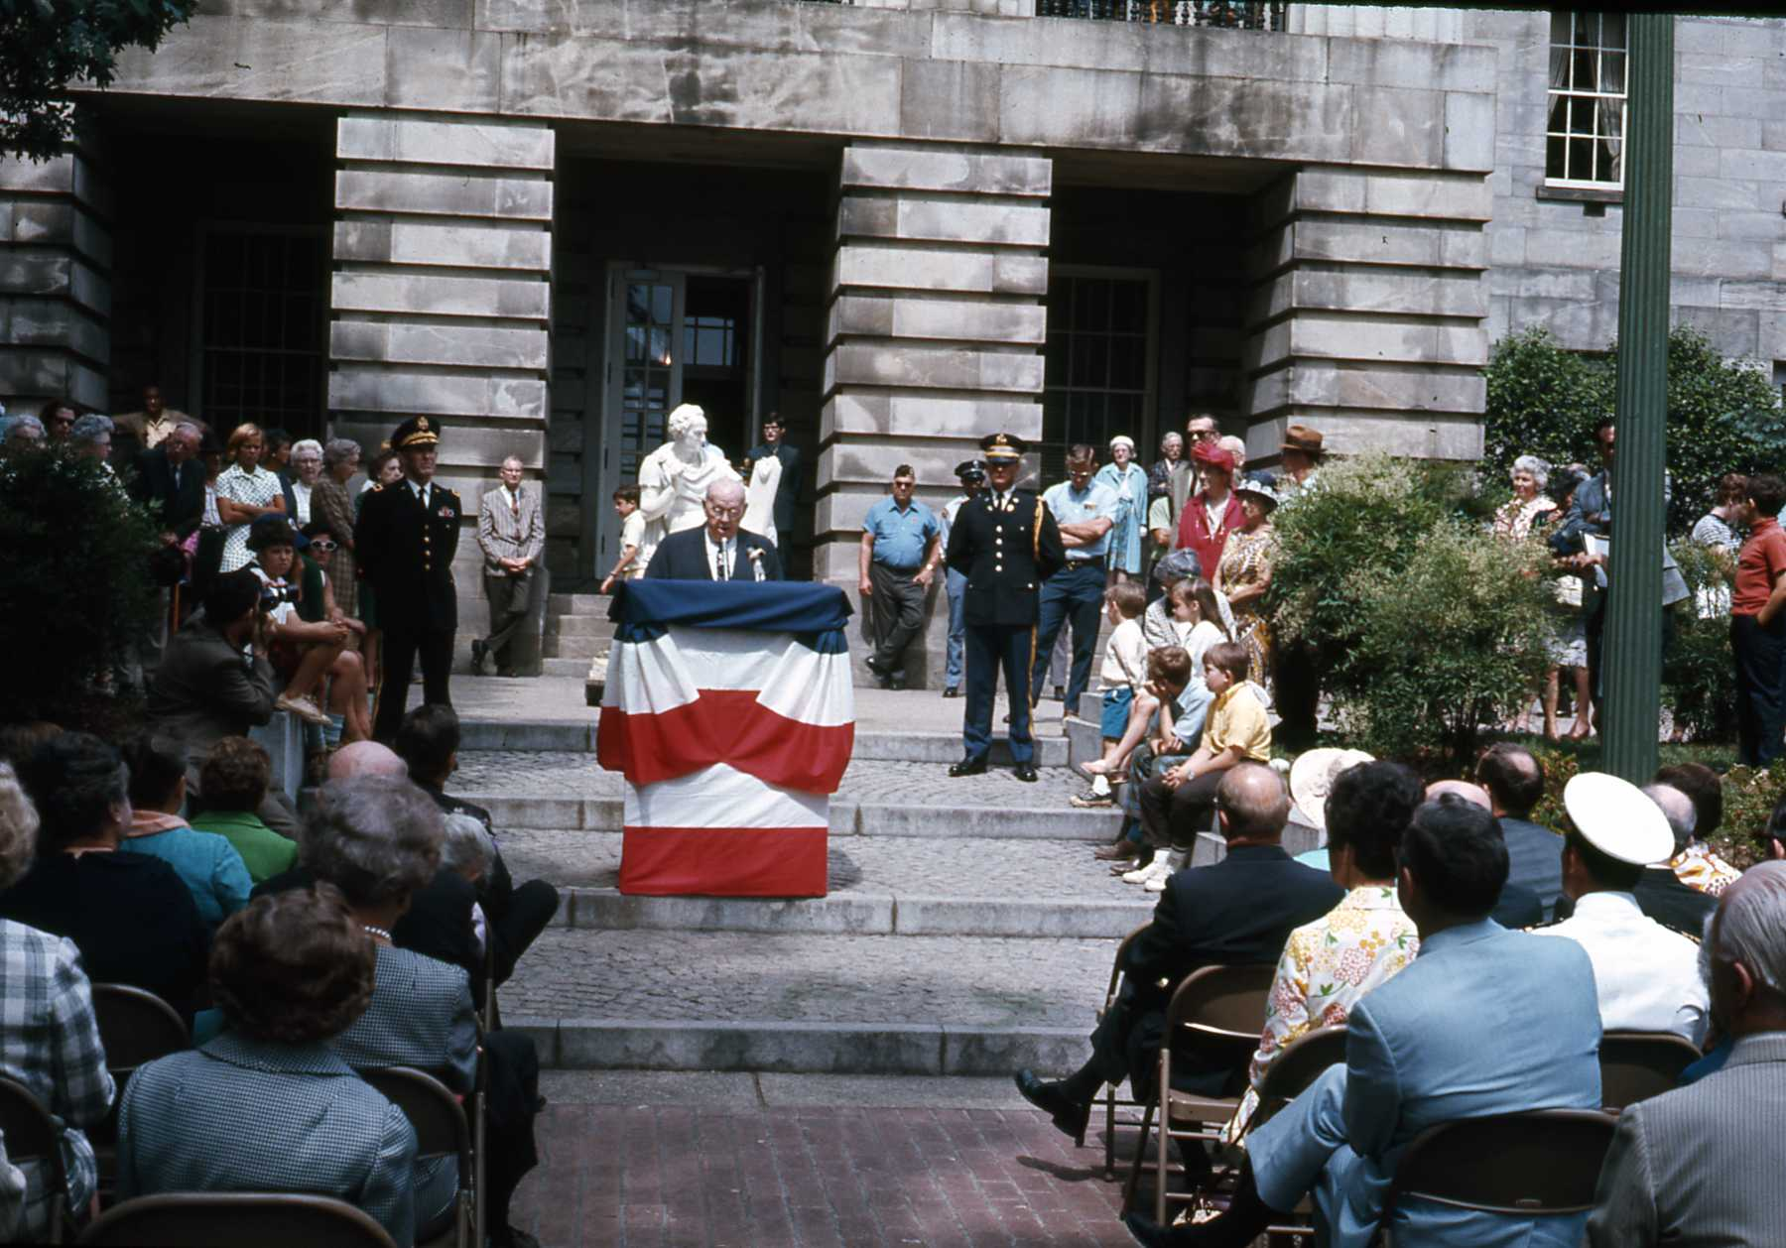
Saturday, May 30, 1970
Dr. H. G. Jones, Head of Archives and History
Archive Research Associates
Copyright © 2010 by Rick Walton
Source: N. C. Capitol Slide Digitization Project
Slide : CI-1-8H-005
Notes:
Dr. H. G. Jones, Head of the dept of Archives and History gave a brief History of the statue. He recalled the State house fire of 1831 resulting in the destruction of the original Canova Statue and explained that the 1840 Capitol was built with space in the rotunda specifically for a replacement statue. He recalled how Annie Ramsey of Raleigh, co chair with Mrs. Albert Edwards of the local DAR chapter’s committee, persuaded the 1963 general assembly to establish the George Washington Statue Commission.

Slide 28
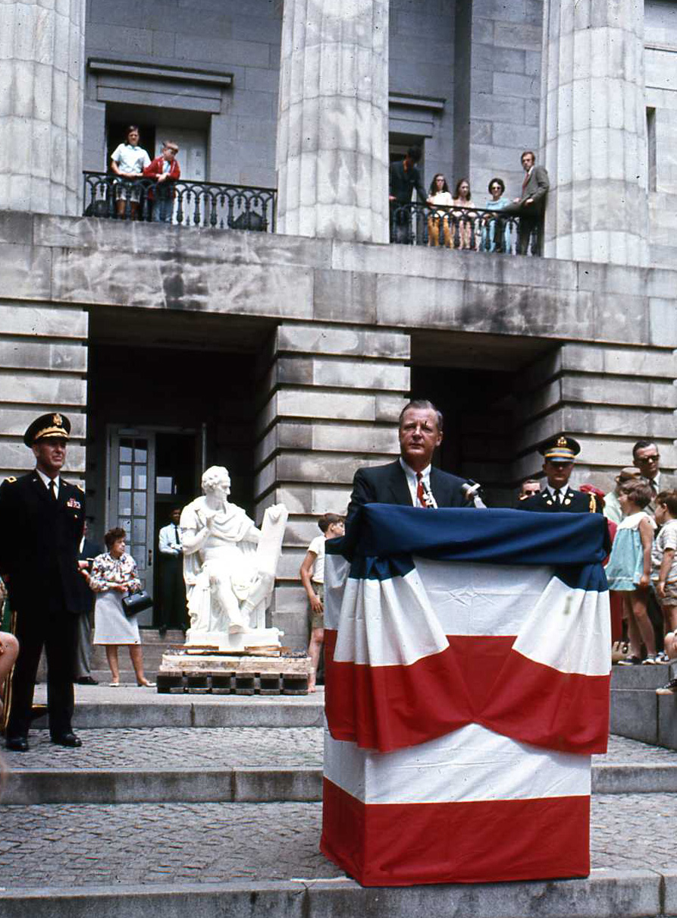
Saturday, May 30, 1970
State Senator Hector Maclean, Chairman of Statue Commission
Archive Research Associates
Copyright © 2010 by Rick Walton
Source: N. C. Capitol Slide Digitization Project
Slide : CI-1-8H-004e
Notes:
State Senator Hector Maclean, of Lumberton, Chairman of Statue Commission spoke briefly and told the crowd that the statue “is not a replica but a duplicate original because it was carved from Canova’s original Model in Possagano, Italy” and mentioned the efforts of State assembly woman Mrs. John B. Chase, representing Wayne county who revived the bill authorizing the placement of the statue in the Capitol Rotunda in 1967.

Slide 29
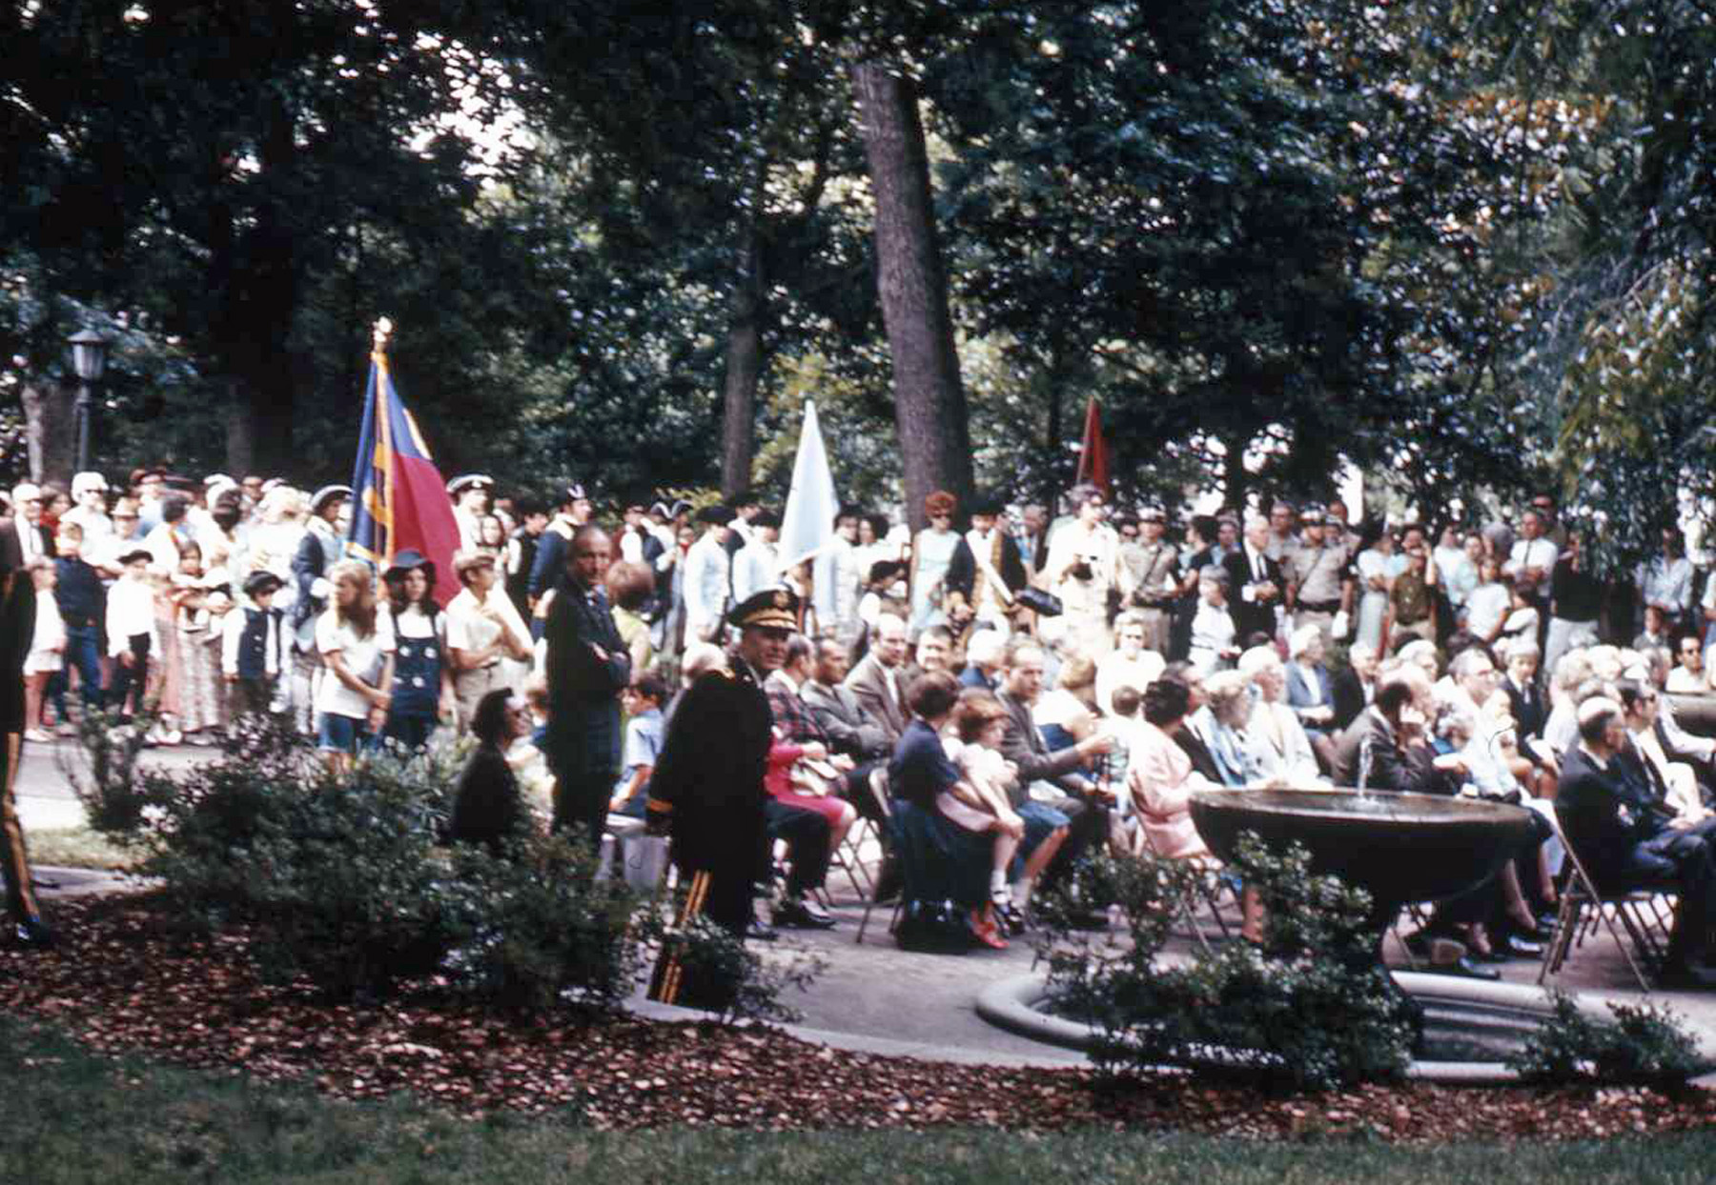
Saturday, May 30, 1970
Spectators watching the Ceremony
Archive Research Associates
Copyright © 2010 by Rick Walton
Source: N. C. Capitol Slide Digitization Project
Slide : CI-1-8H-009e
Notes:
Spectators on the plaza in front of the East Capitol Entrance, In front of the 3 Presidents Statue. The fountains are still in place today.

Slide 30
Placed in the Rotunda
Archive Research Associates
Copyright © 2010 by Rick Walton
Notes:
“Then began the delicate task of getting the statue into the Capitol And beneath the Rotunda” (undated newspaper article)

Slide 31
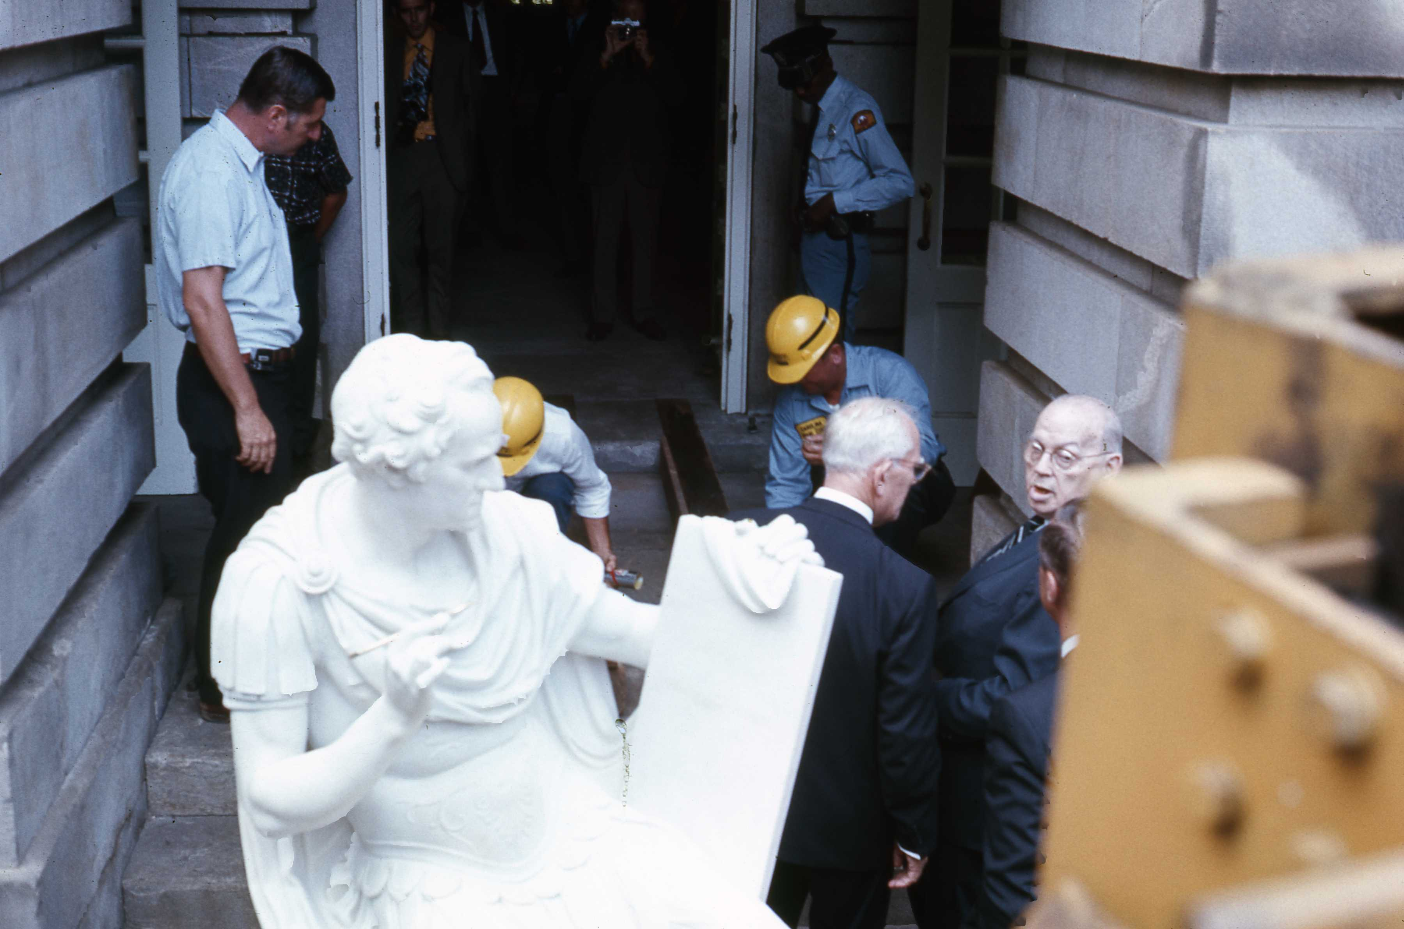
Saturday, May 30, 1970
Statue Lifted by forklift though East door of Capitol
Archive Research Associates
Copyright © 2010 by Rick Walton
Source: N. C. Capitol Slide Digitization Project
Slide : CI-1-8D-005, undated newspaper Article
Notes:
A fork lift (Yellow Macine in right foreground) was used to hoist the heavy statue, sitting on temporary wooden pallets, from the sidewalk onto prepared, greased treads leading to the rotunda from the East entrance to the Capitol.

Slide 32
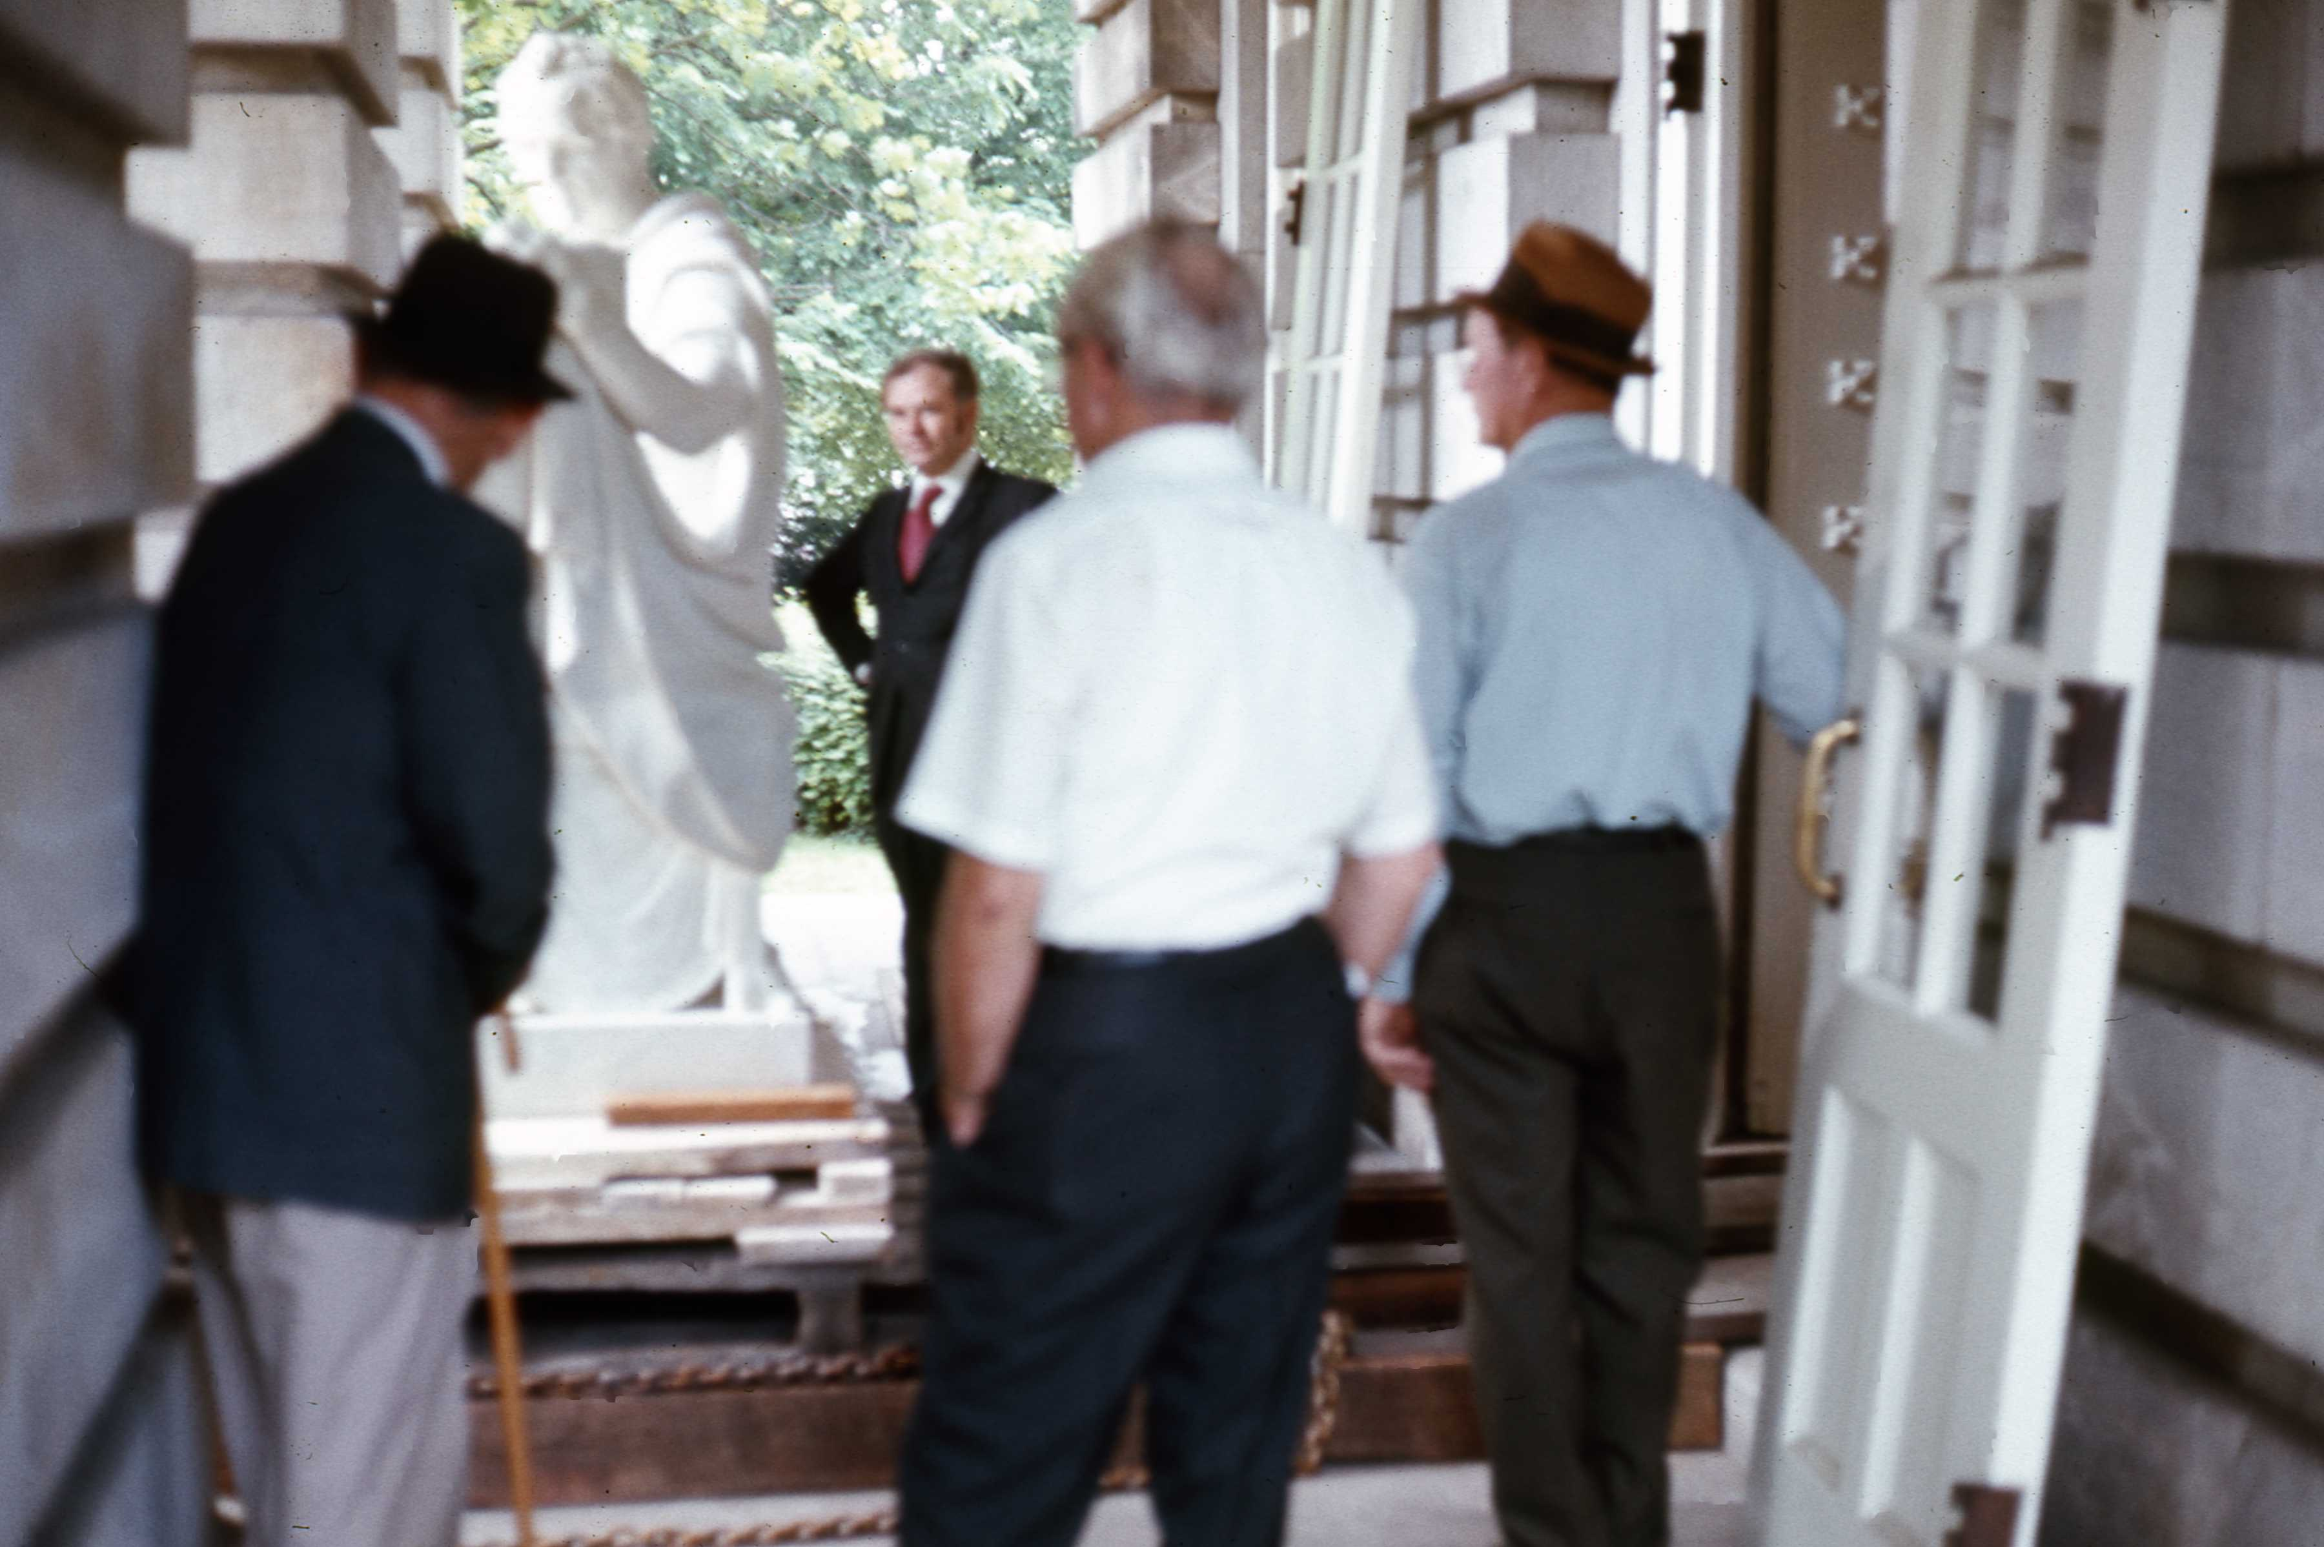
Saturday, May 30, 1970
Statue in East Portico (Notice Doors)
Archive Research Associates
Copyright © 2010 by Rick Walton
Source: N. C. Capitol Slide Digitization Project
Slide : CI-1-8D-009, undated newspaper Article
Notes:
This view, taken from the side of the Entrance, shows the entrance doors removed and the statue on a pallet that is being winched along wooden beams laid on the floor.

Slide 33
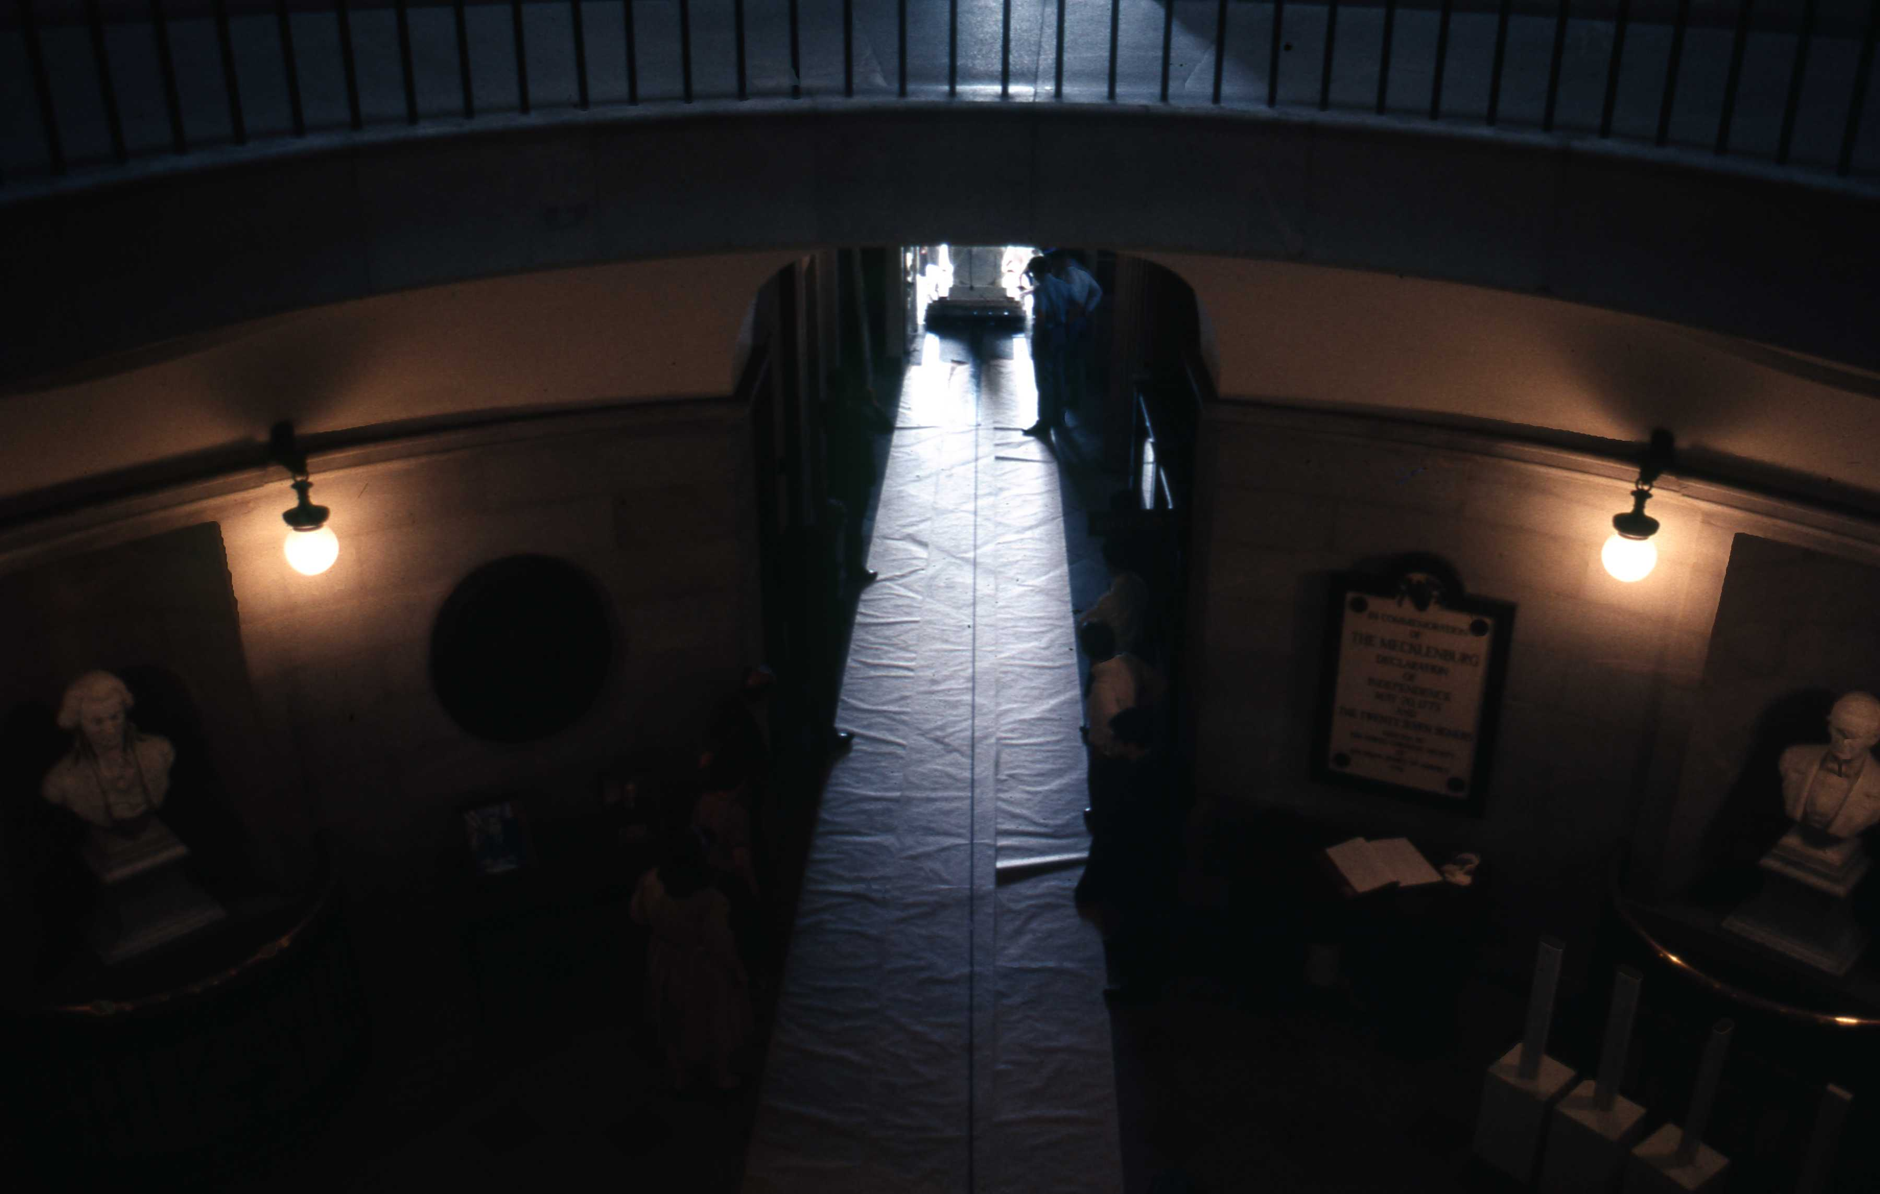
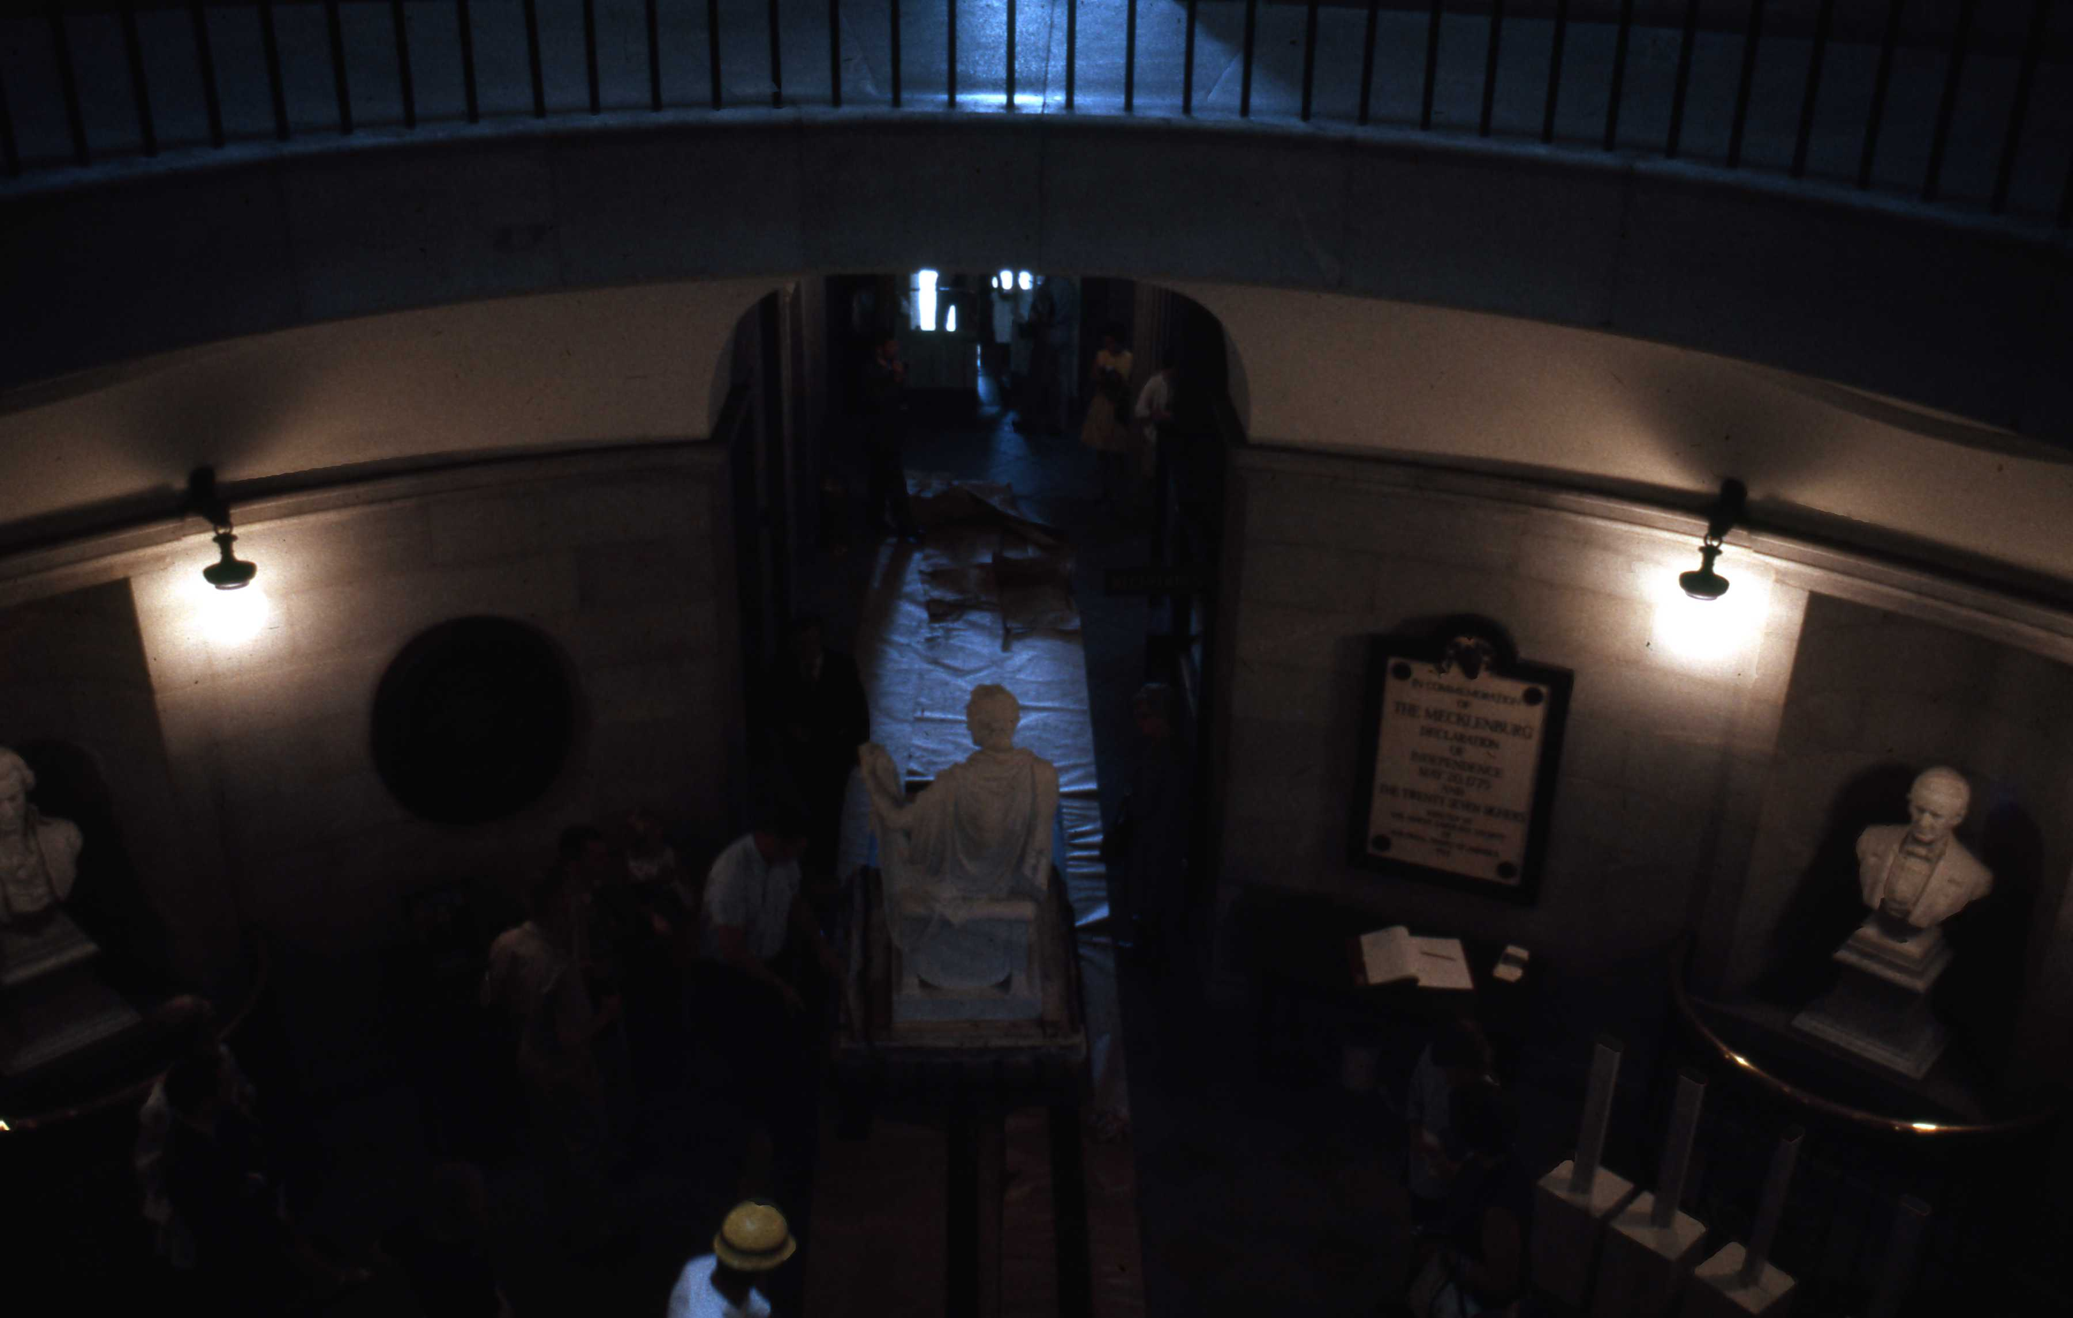
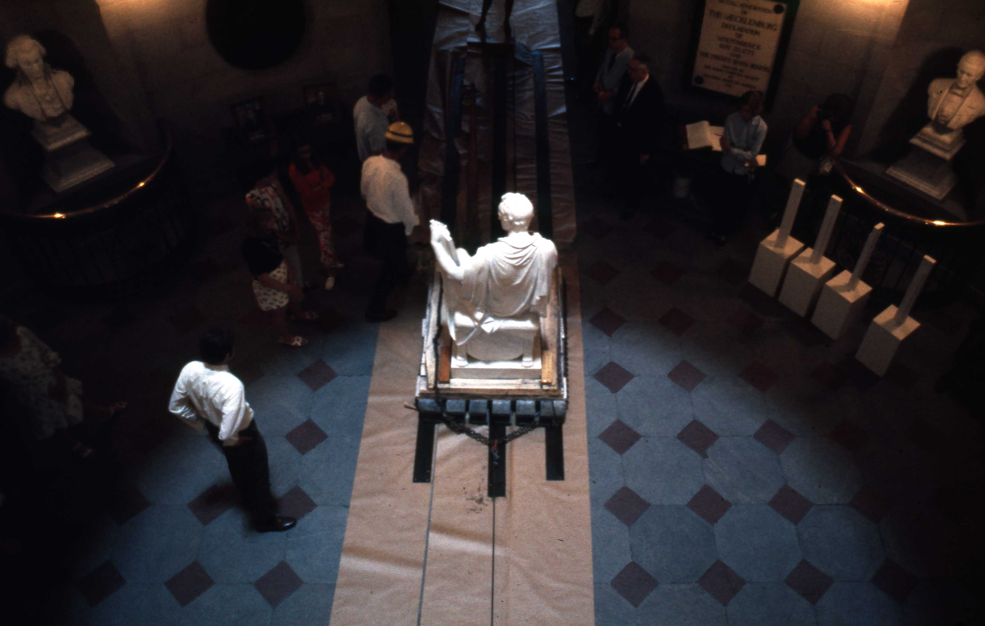
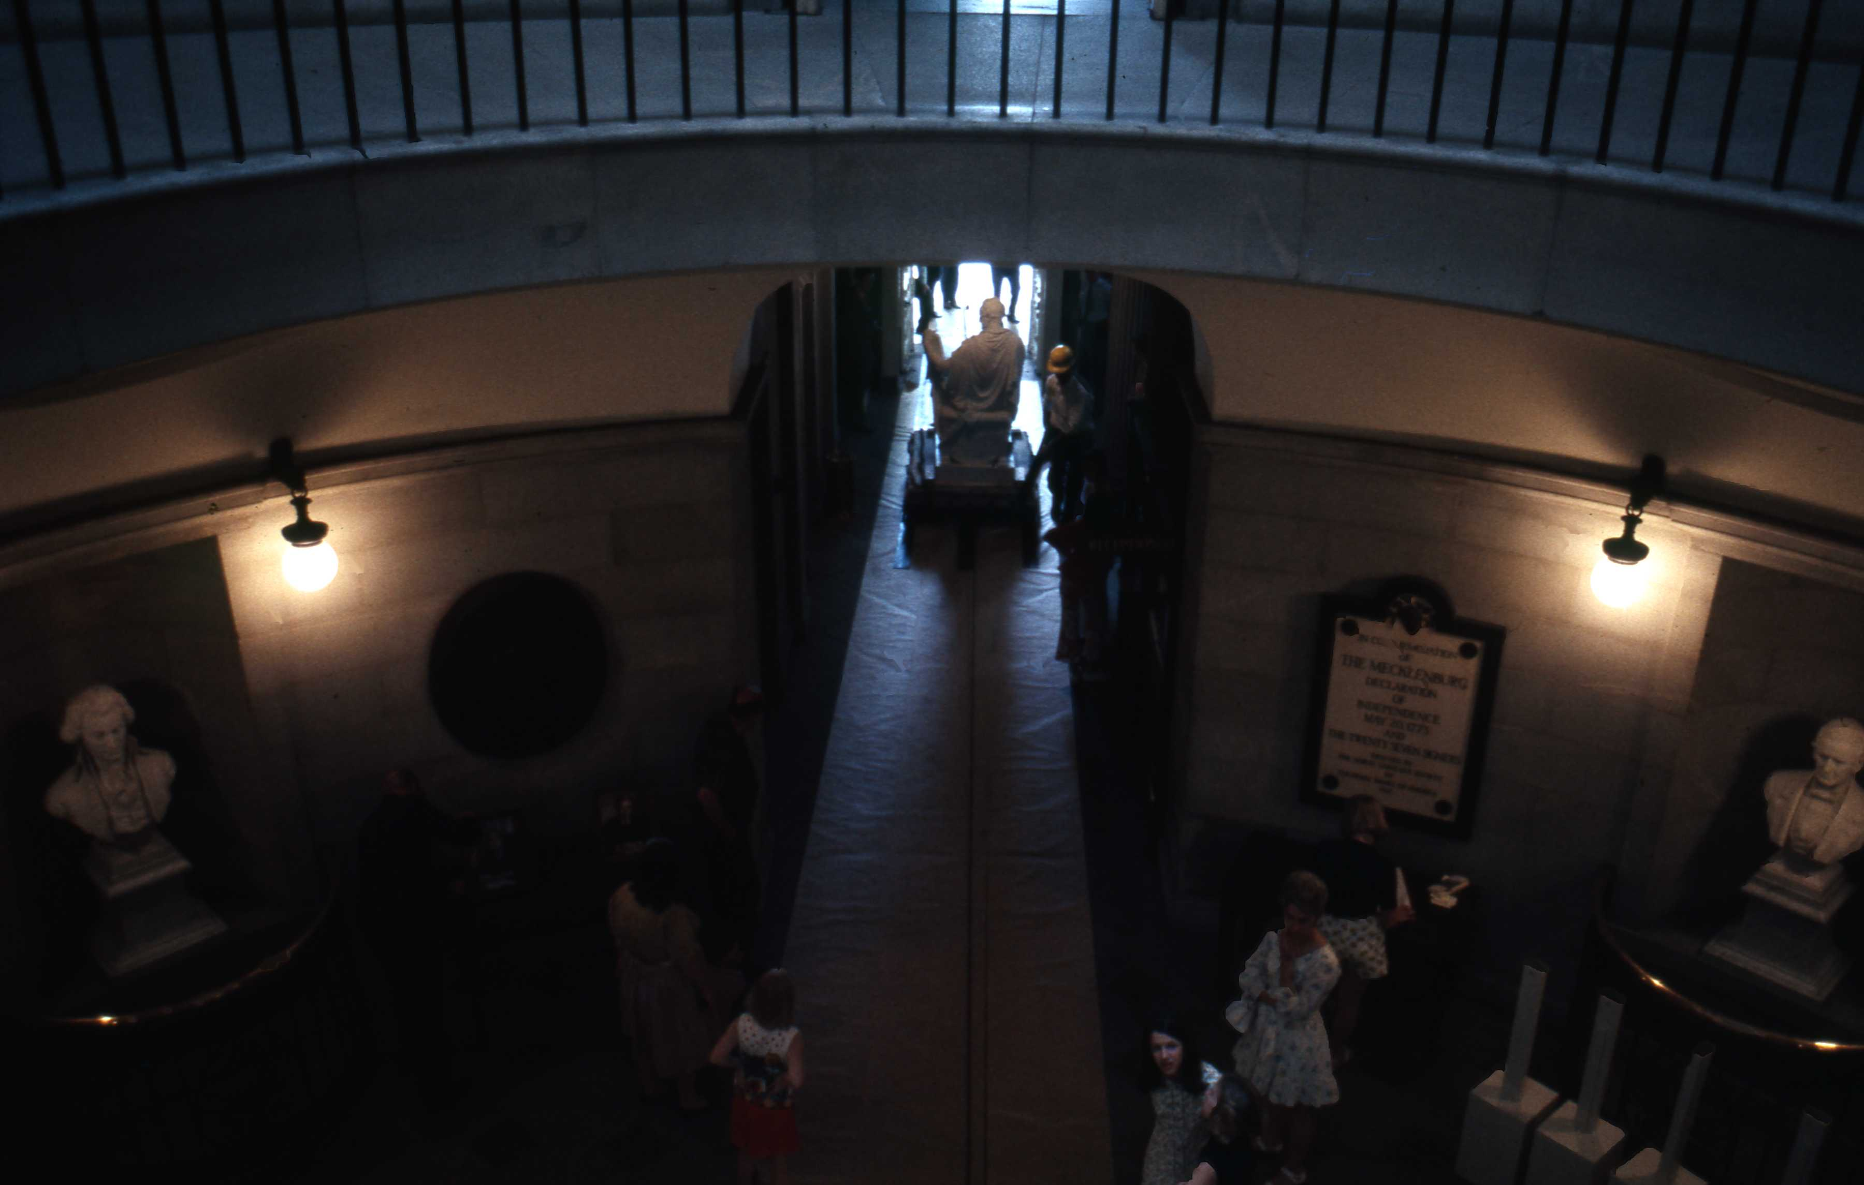
Saturday, May 30, 1970
George’s Grand Entrance
Archive Research Associates
Copyright © 2010 by Rick Walton
Notice Spectators
Winch Cable ➔
Source: N. C. Capitol Slide Digitization Project
Slide : CI-1-8D-003, 004, 010,011
undated newspaper Article
Notes:
Statue is inched slowly into the rotunda using a winch and greased skids. Notice the spectators watching

Slide 34
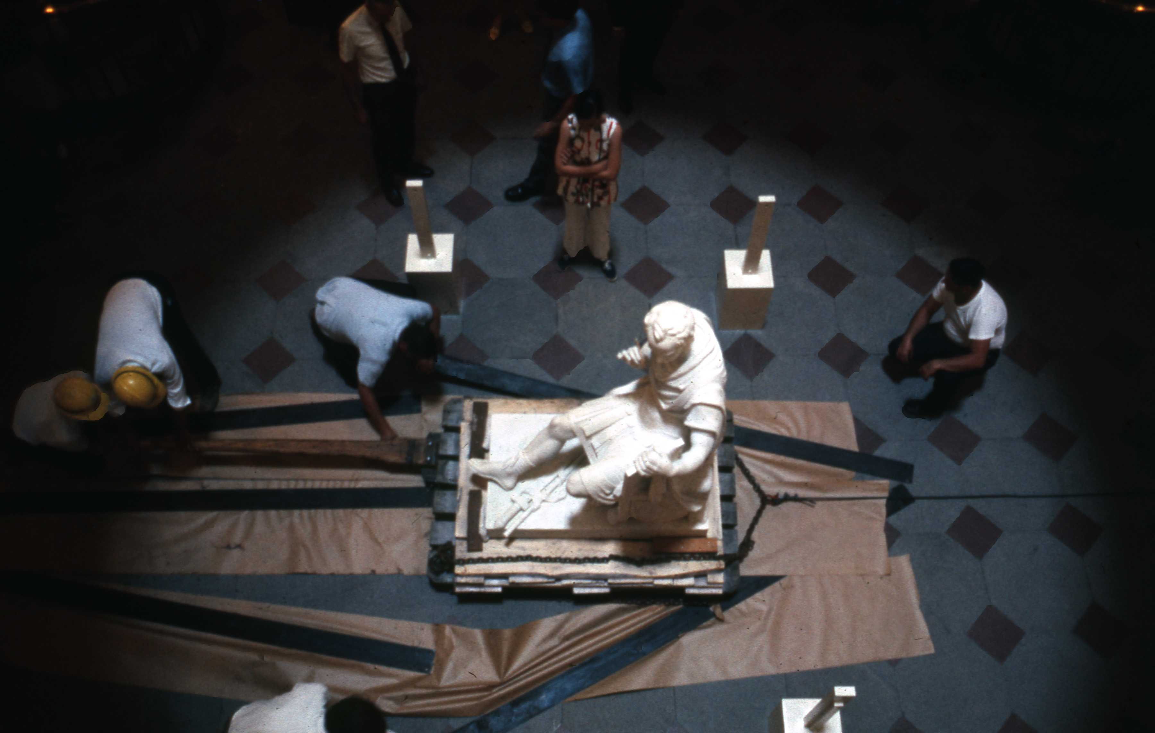
Saturday, May 30, 1970
Statue reaches final location to await the base
Archive Research Associates
Copyright © 2010 by Rick Walton
Source: N. C. Capitol Slide Digitization Project
Slide : CI-1-8D-013,
Notes:
The statue is carefully located, atop temporary wooden pallets, in the center of the rotunda until the base arrives and the statue can be mounted.

Slide 35
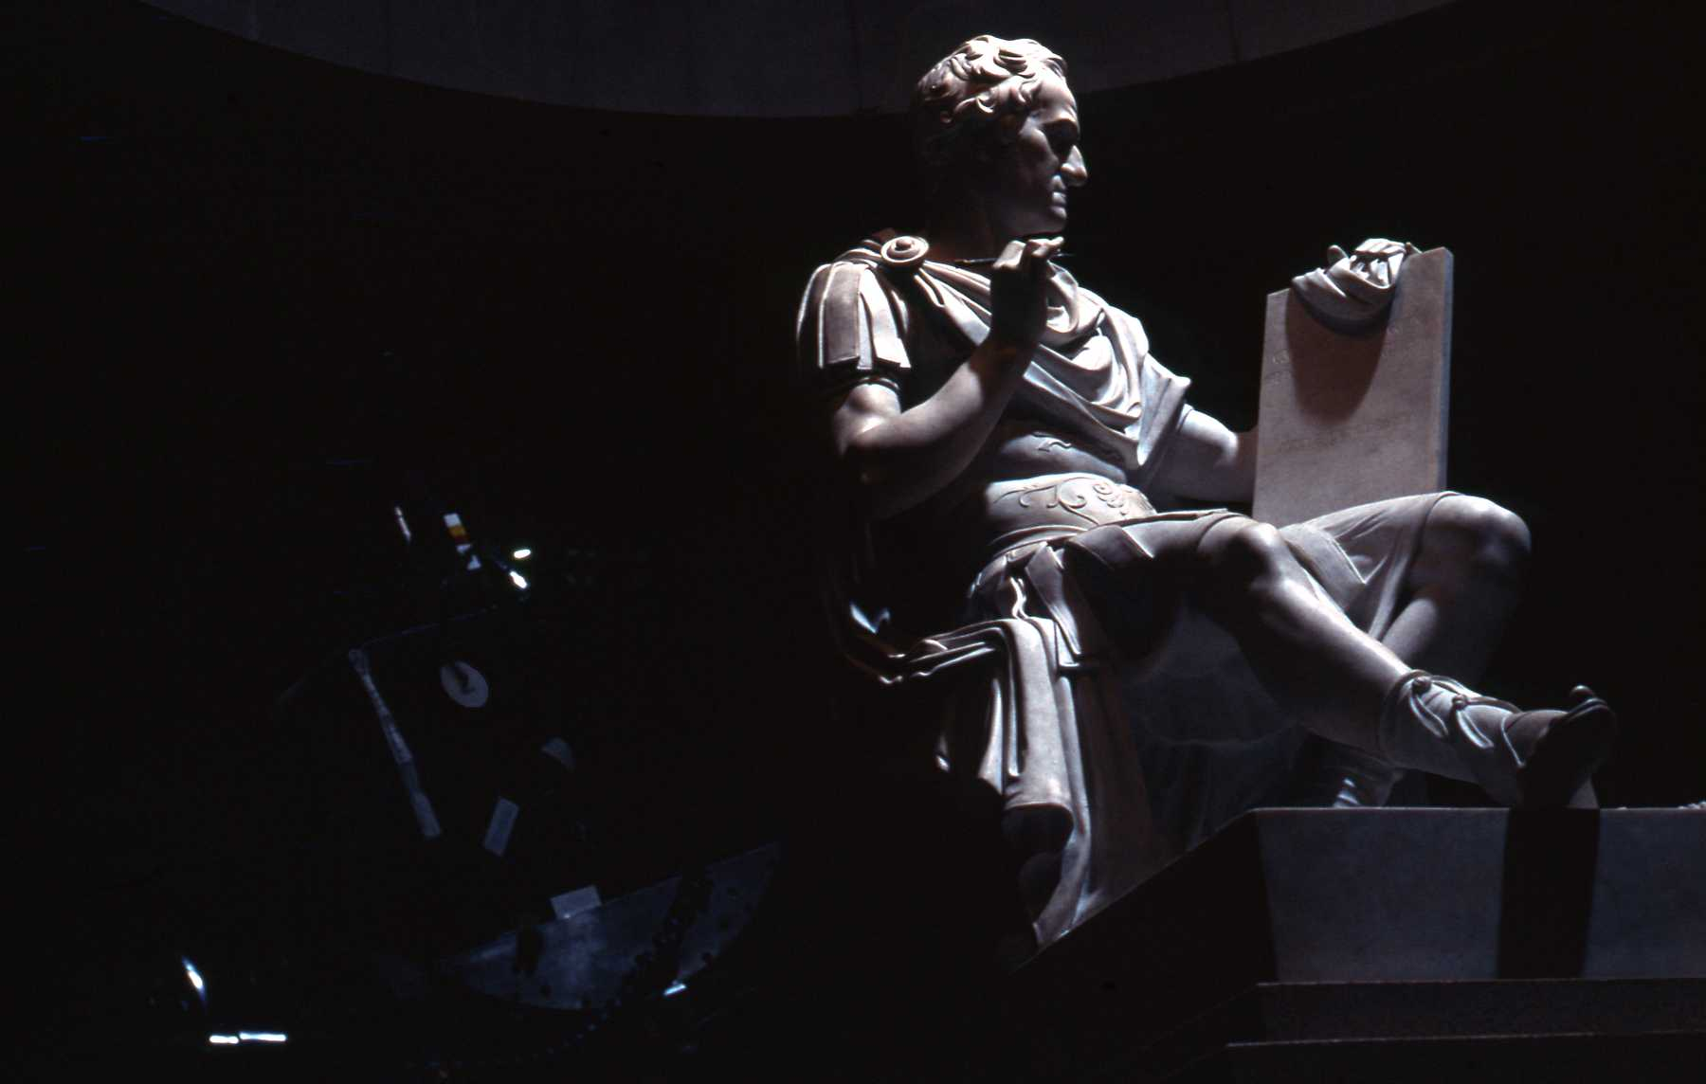
Cost of Statue
Cost :
about $20,000
raised from Private sources
Free Transportation:
Provided by U.S. Navy
and Moss Trucking
Archive Research Associates
Copyright © 2010 by Rick Walton
Source: N. C. Capitol Slide Digitization Project
Slide : CI-1-8-009,
Undated newspaper Article

Slide 36
Controversy with the Base
Archive Research Associates
Copyright © 2010 by Rick Walton

Slide 37
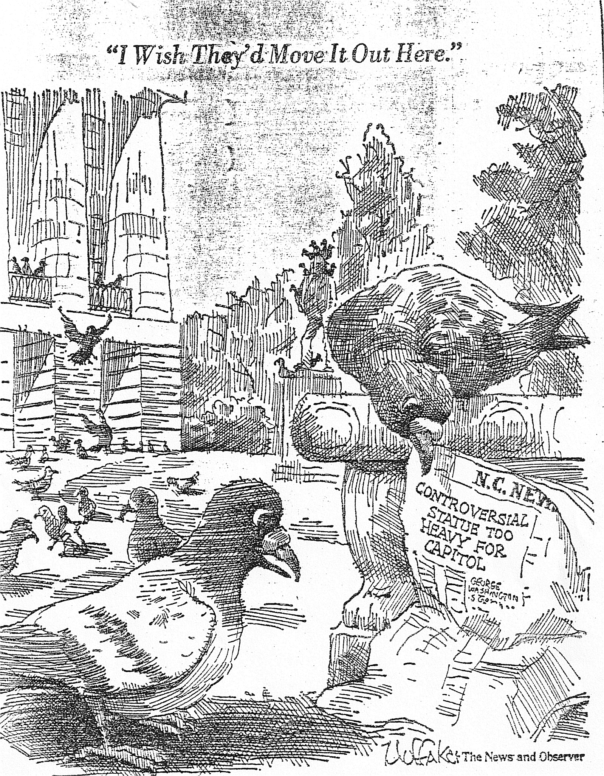
Archive Research Associates
Copyright © 2010 by Rick Walton
Source: N&O , October 1970
Notes:
The statue is an easy target for Political cartoons in 1970.

Slide 38
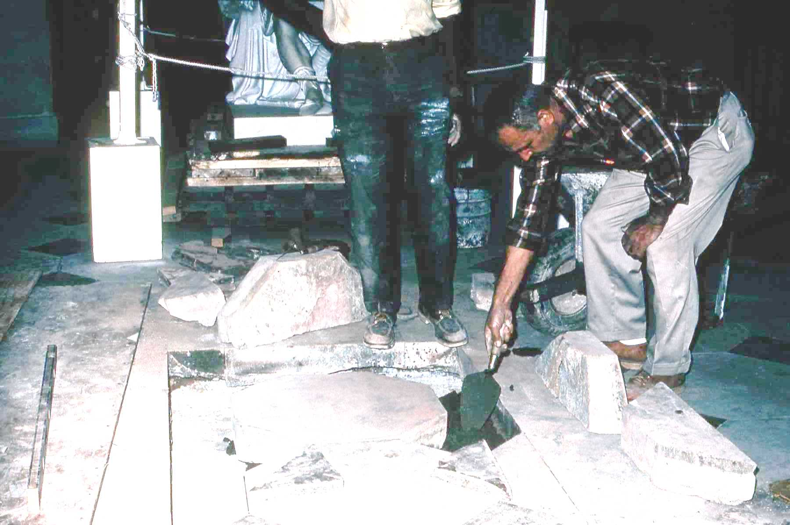
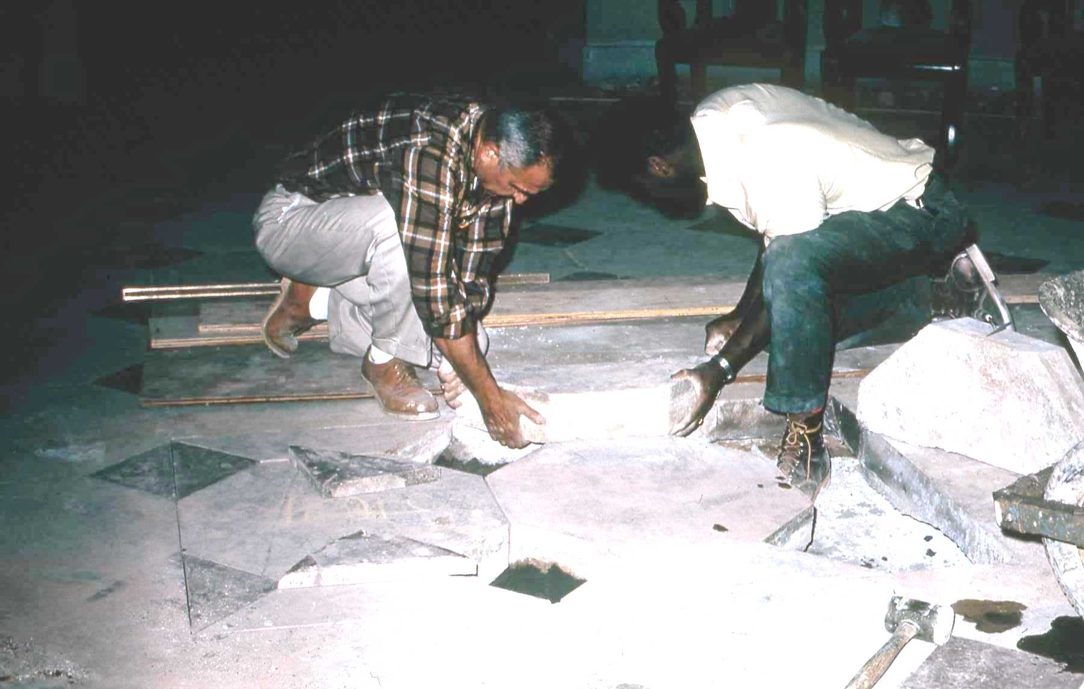
Preparing floor for base foundation
Archive Research Associates
Copyright © 2010 by Rick Walton
Source: N. C. Capitol Slide Digitization Project
Slide : CI-1-9-001e
Notes:
The Floor was carefully cut and removed, revealing the original foundation from the Canova statue from before the 1831 fire.

Slide 39
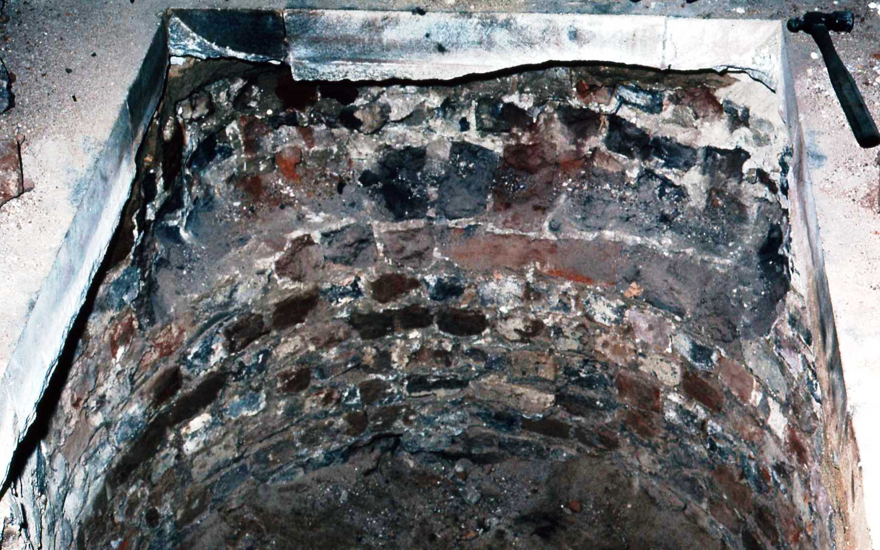
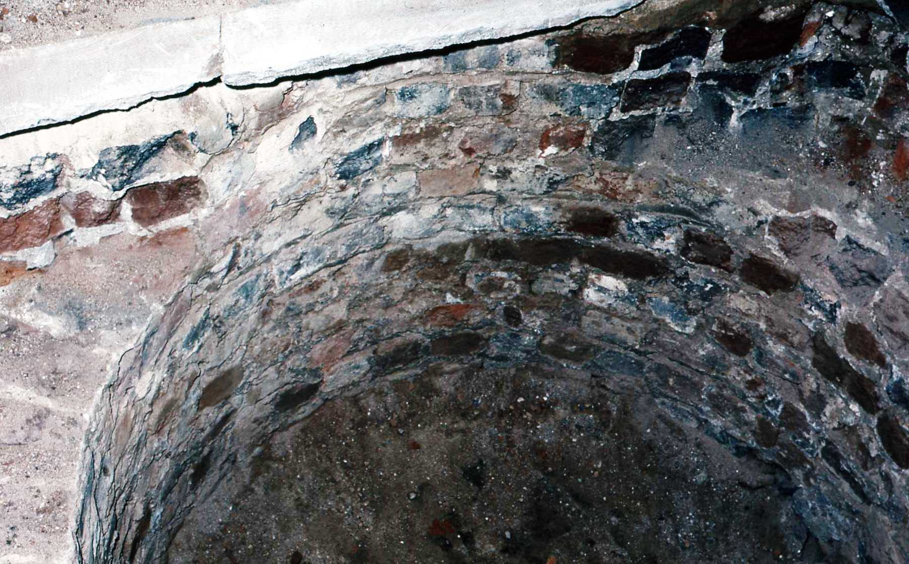
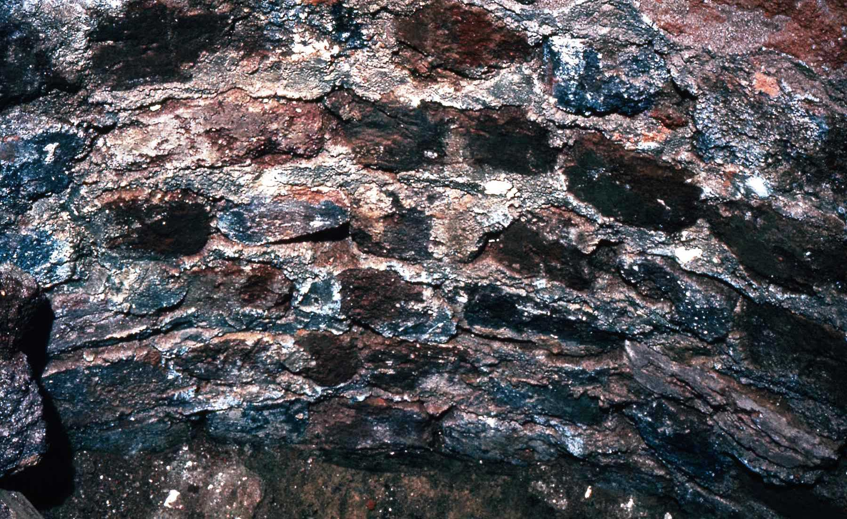
Original State House Statue Foundation Discovered
Archive Research Associates
Copyright © 2010 by Rick Walton
Source: N. C. Capitol Slide Digitization Project
Slide : CI-1-9-009

Slide 40
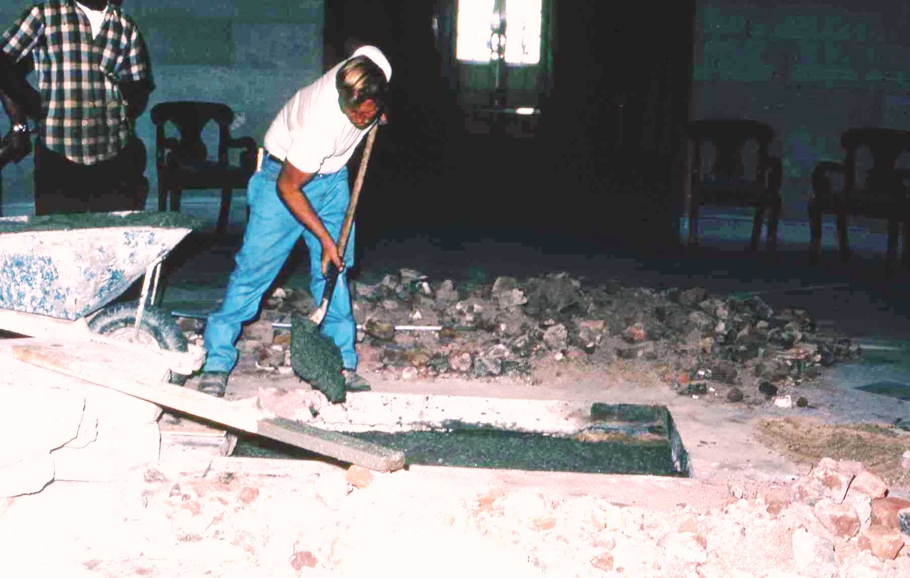
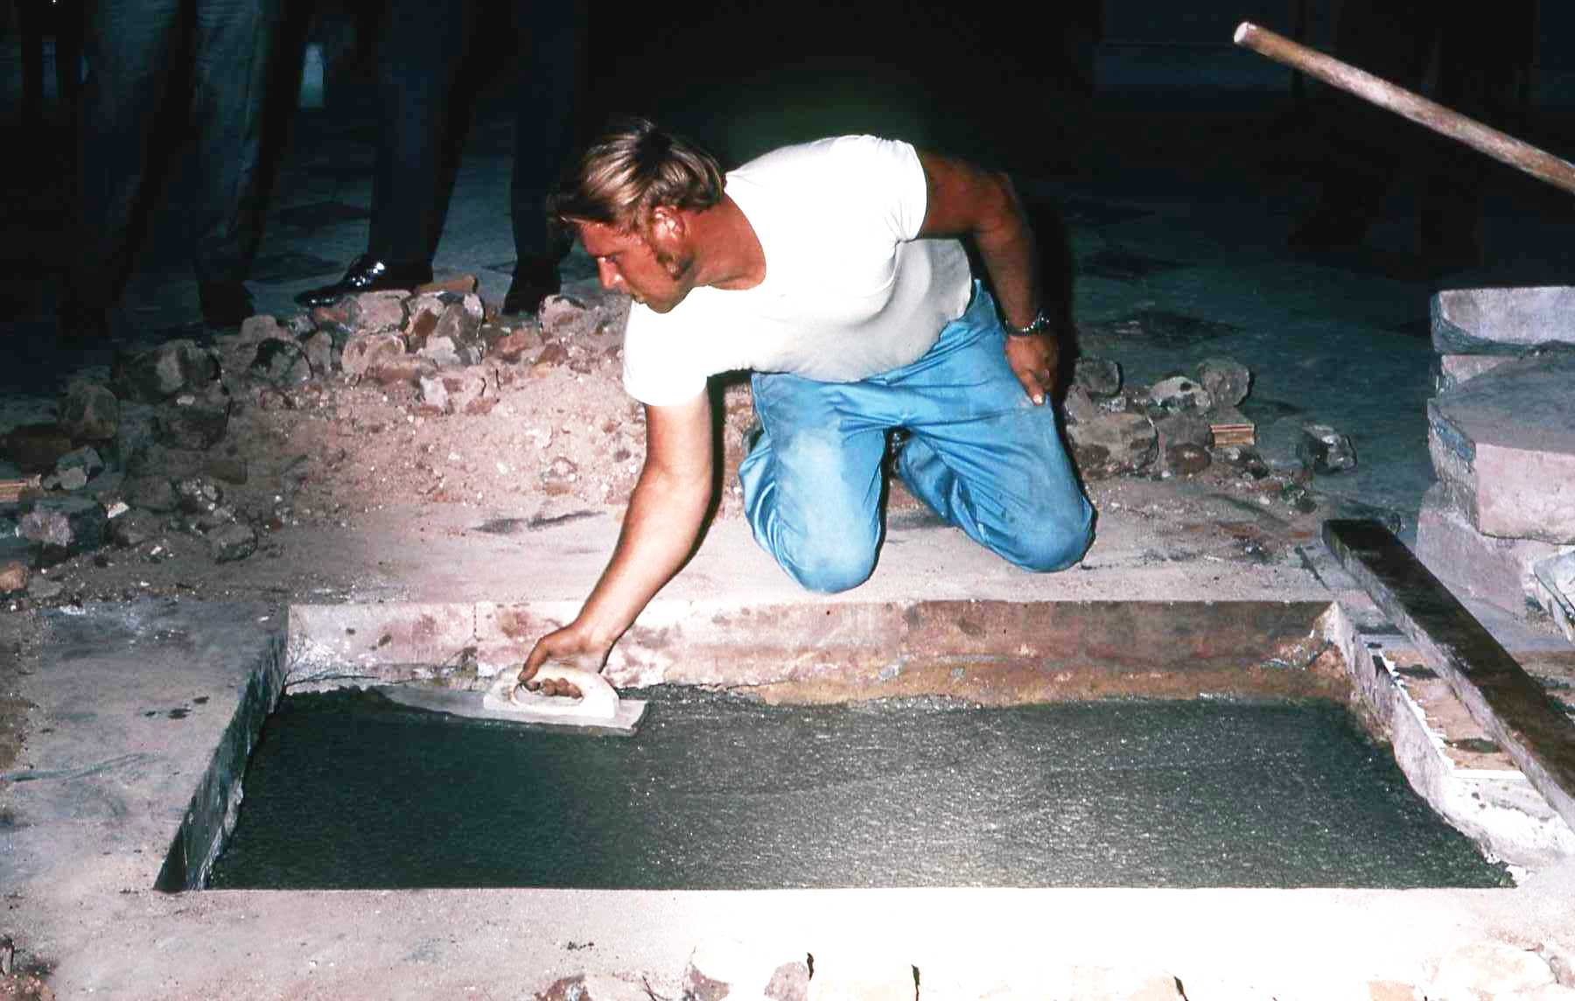
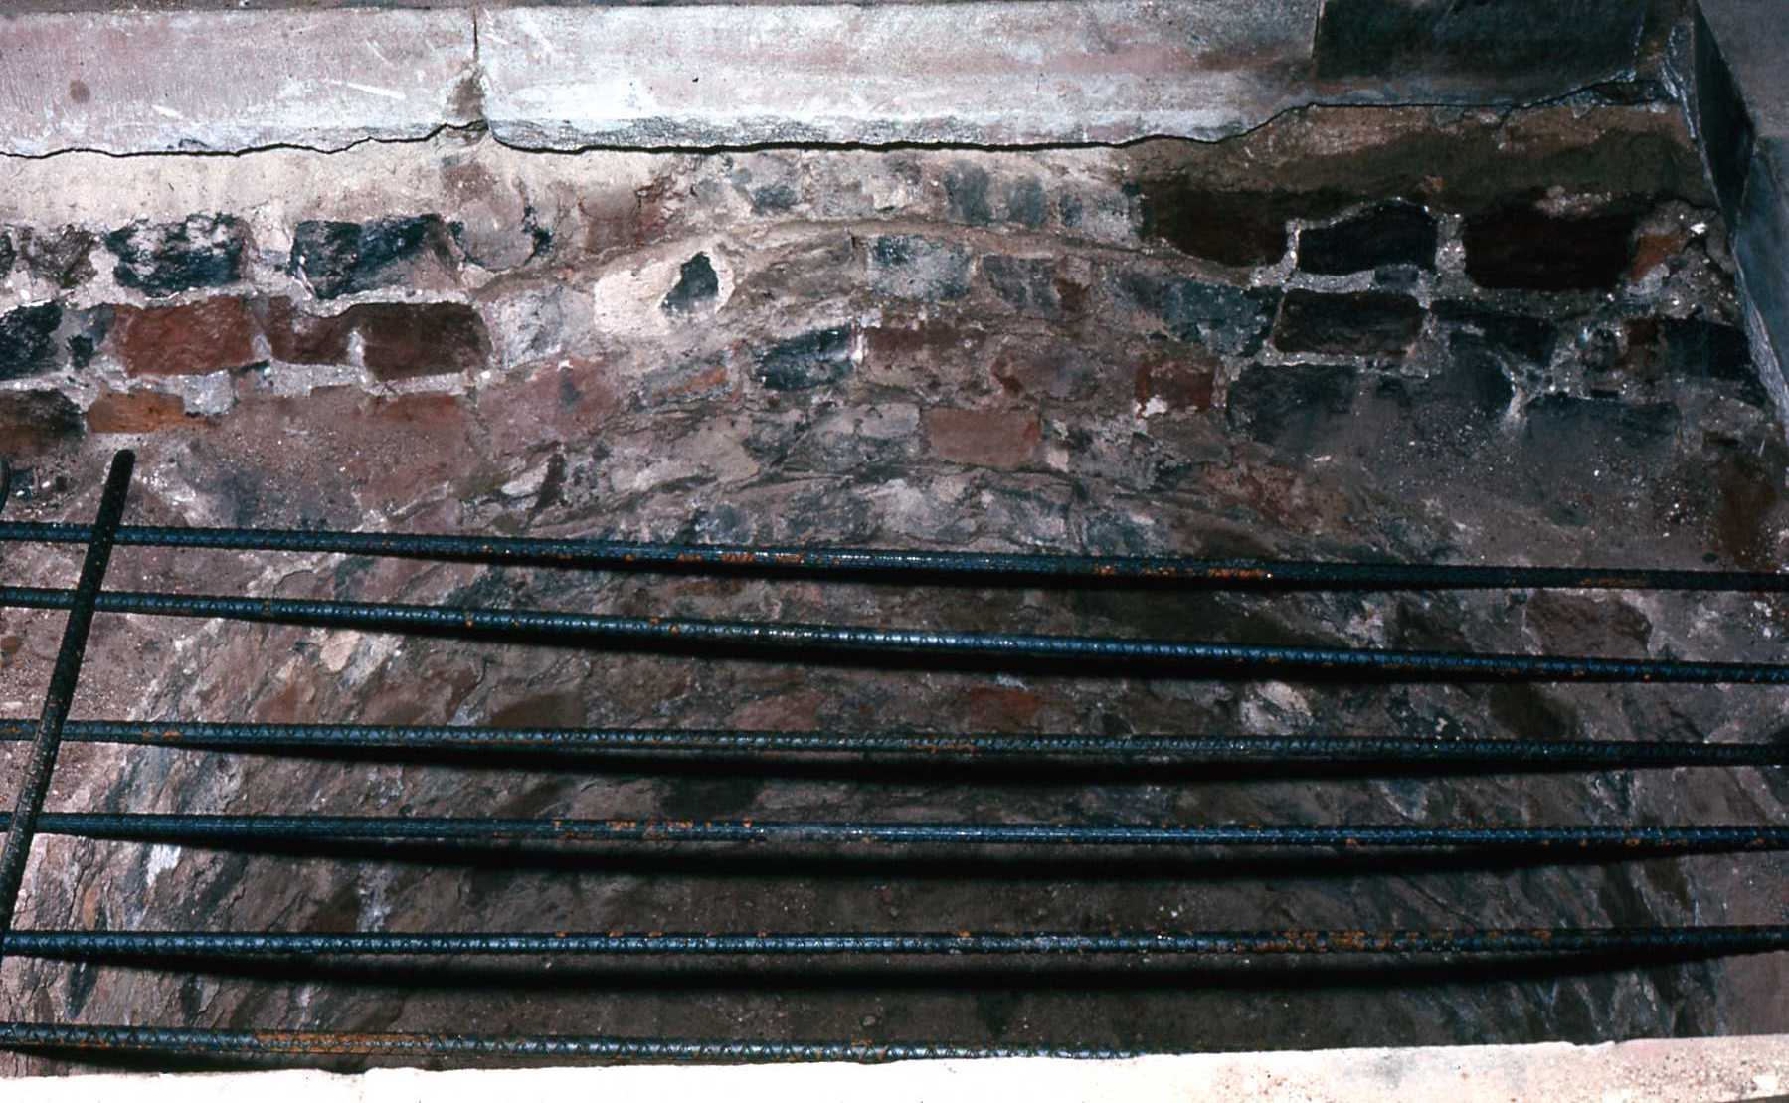
Pouring concrete
Archive Research Associates
Copyright © 2010 by Rick Walton
Source: N. C. Capitol Slide Digitization Project
Slide : CI-1-9-003e, 004e, 006
Notes:
A modern foundation is prepared.

Slide 41
Installing the Base
Archive Research Associates
Copyright © 2010 by Rick Walton
Notes:
“Then began the delicate task of getting the statue into the Capitol And beneath the Rotunda” (undated newspaper article)

Slide 42
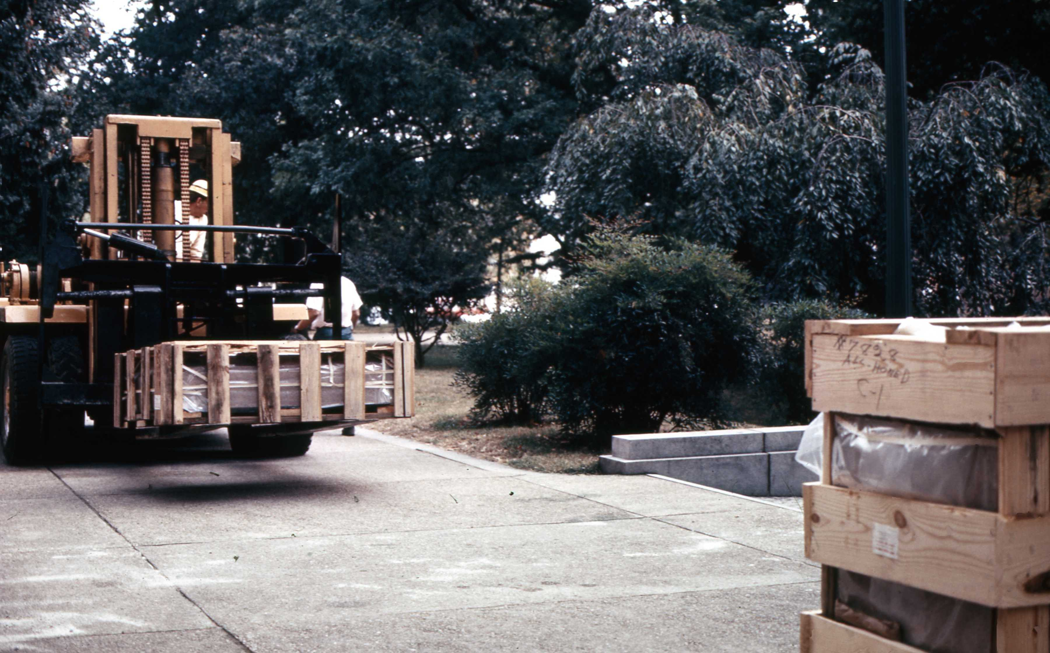
Thursday, October 8, 1970
Preparing the base
Archive Research Associates
Copyright © 2010 by Rick Walton
Source: N. C. Capitol Slide Digitization Project
Slide : CI-1-8c-014

Slide 43
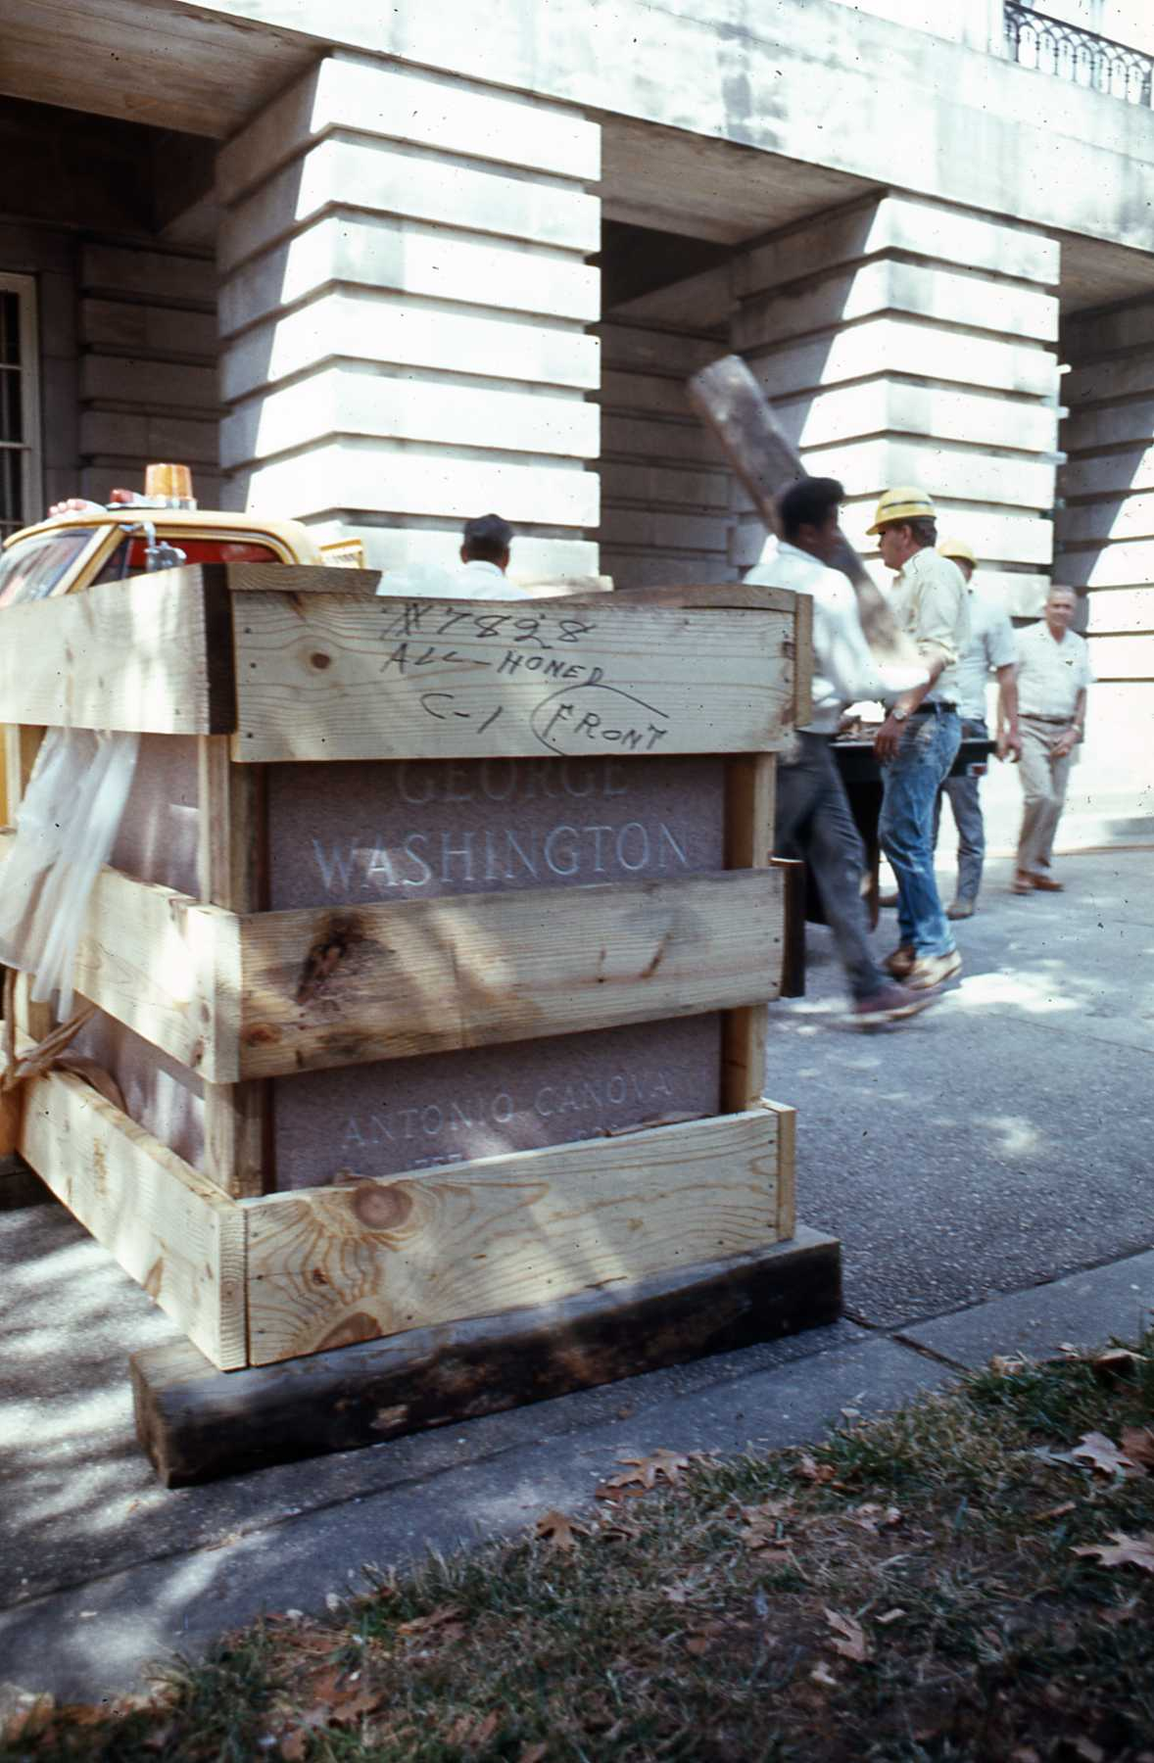
Thursday, October 8, 1970
Preparing the base
Archive Research Associates
Copyright © 2010 by Rick Walton
Source: N. C. Capitol Slide Digitization Project
Slide : CI-1-8c-008

Slide 44
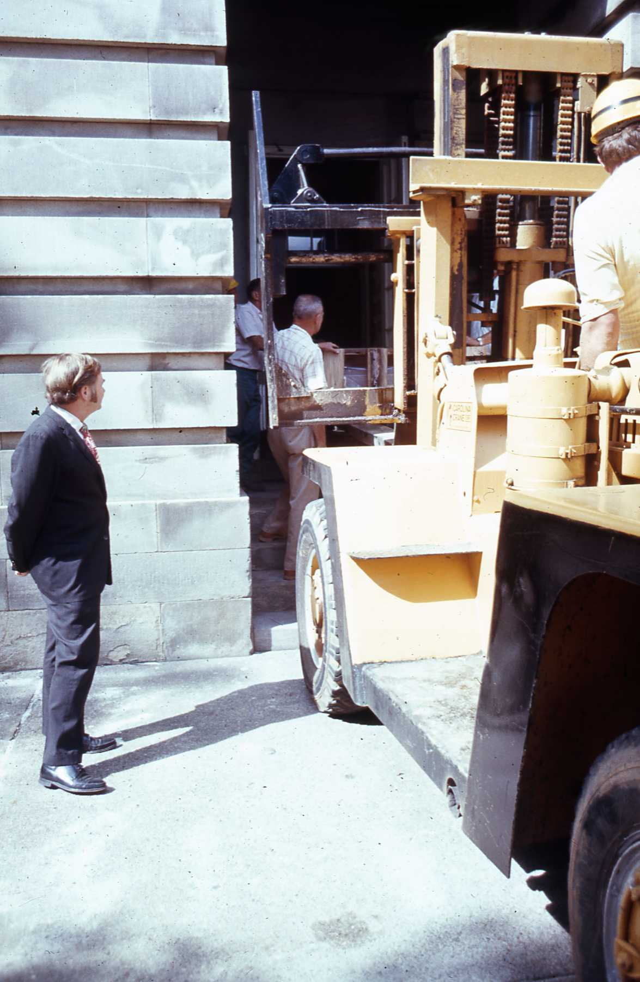
Thursday, October 8, 1970
Preparing the base
Archive Research Associates
Copyright © 2010 by Rick Walton
Source: N. C. Capitol Slide Digitization Project
Slide : CI-1-8c-009

Slide 45
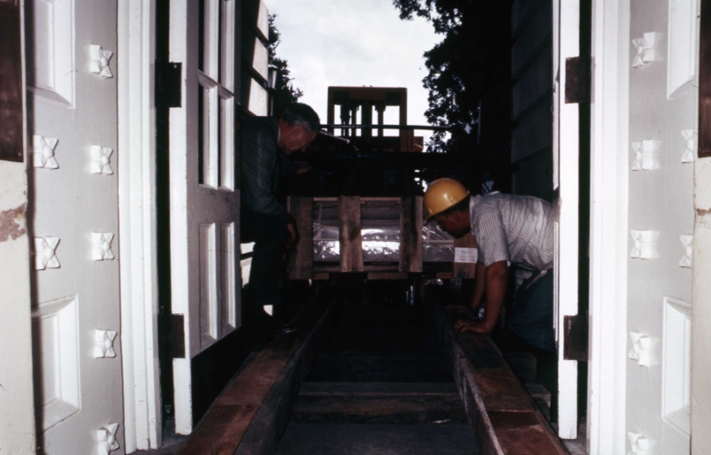
Thursday, October 8, 1970
Preparing the base
Archive Research Associates
Copyright © 2010 by Rick Walton
Source: N. C. Capitol Slide Digitization Project
Slide : CI-1-8c-015
Notes:
View from inside Capitol looking out, notice the exterior doors.

Slide 46

Thursday, October 8, 1970
Preparing the base
Archive Research Associates
Copyright © 2010 by Rick Walton
Source: N. C. Capitol Slide Digitization Project
Slide : CI-1-8c-002e

Slide 47

Thursday, October 8, 1970
Preparing the base
Archive Research Associates
Copyright © 2010 by Rick Walton
Source: N. C. Capitol Slide Digitization Project
Slide : CI-1-8D-002

Slide 48

Thursday, October 8, 1970
Preparing the base
Archive Research Associates
Copyright © 2010 by Rick Walton
Source: N. C. Capitol Slide Digitization Project
Slide : CI-1-8c-005e

Slide 49

Weighty Matters
How much does it Weigh?
13,100 Lbs
6.55 Tons
Capstone-
2,200 Lbs
Archive Research Associates
Copyright © 2010 by Rick Walton
Center Pedestal- 7,300 Lbs
Base- 3,600 Lbs
Source: N. C. Capitol Slide Digitization Project
Slide : CI-1-8EE-004,
N&O article -9 Oct 1970, James Hogarth- Physical Plant Director, State Dept of Admin

Slide 50
Final Placement
Archive Research Associates
Copyright © 2010 by Rick Walton

Slide 51

Friday, October 9, 1970
Statue Lifted to top of Base with Forklift
Archive Research Associates
Copyright © 2010 by Rick Walton
Source: N. C. Capitol Slide Digitization Project
Slide : CI-1-8EE-007e

Slide 52

Friday, October 9, 1970
Final Adjustments
Archive Research Associates
Copyright © 2010 by Rick Walton
Source: N. C. Capitol Slide Digitization Project
Slide : CI-1-8E-001

Slide 53

Friday, October 9, 1970
Final Adjustments
Archive Research Associates
Copyright © 2010 by Rick Walton
Source: N. C. Capitol Slide Digitization Project
Slide : CI-1-8F-001

Slide 54

Friday, October 9, 1970
Final Adjustments
Archive Research Associates
Copyright © 2010 by Rick Walton
Source: N. C. Capitol Slide Digitization Project
Slide : CI-1-8F-010

Slide 55

Archive Research Associates
Copyright © 2010 by Rick Walton
Notes:
A contemporary view of the statue.

Slide 56
The End
Archive Research Associates
Copyright © 2010 by Rick Walton

Slide 57
Slides scanned by
Rick Walton
From original 35mm slides in the NC State Capitol collection as part of the Digitization project
Archive Research Associates
Copyright © 2010 by Rick Walton

Slide 58
Research by
Rick Walton
Archive Research Associates
Copyright © 2010 by Rick Walton

